Slide 1
Digital Filmmaking
Telling Stories through Technology

Slide 2
Presentations
Luna, Kevin, Daniel, Ashley
Charlotte, Alan, April
Jason, Lilly, Tenny, Olivia
Helio, Joyce, Coco

Slide 3
Prepping for Production

Slide 4
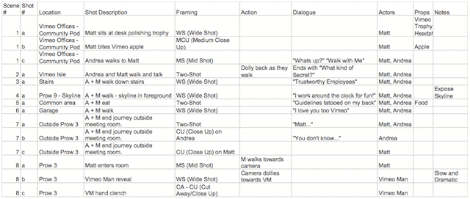
Shot List
Works the same way as a storyboard, but is more technical.
Shot list is a full log of all the shots you want to include in your film; essentially it is a checklist filled with minute details that will give your film a sense of direction and efficiency.
Shot lists help you consider shooting footage based on location and setup; not necessarily in the order of the story.

Slide 5
Scene? Shot?
A scene is a unit of story that takes place at a specific location and time.
If one of these changes, you have a new scene.
A scene consists of multiple shots.
A shot is a single continuous angle of view that probably only shows one part of the action at the scene.
Multiple shots make up a scene.

Slide 6
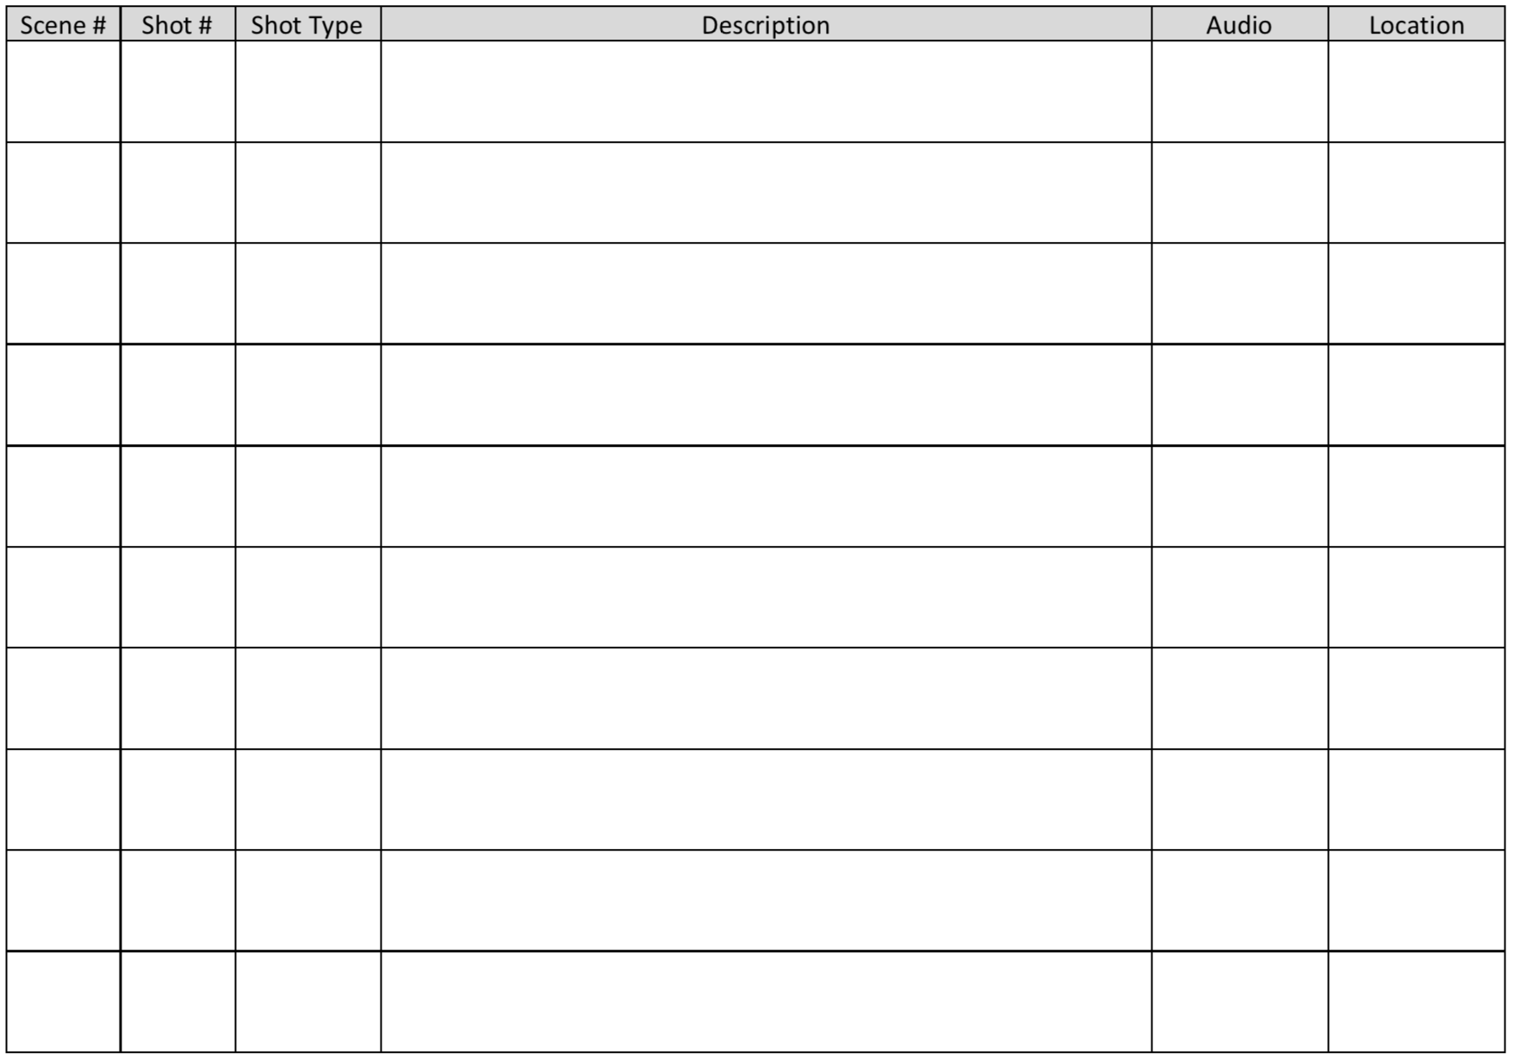

Slide 8
Post-Production

Slide 9
Video Editing: The process of manipulating video images.

Slide 10
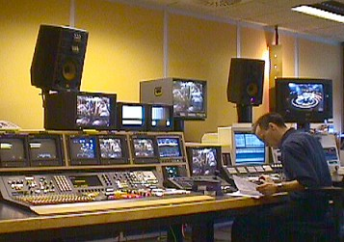
Broadcasting & Editing system setup in the past

Slide 11


Slide 12
Video Editing
Video editing software has increasingly become common, especially with the advent of Apple’s Final Cut suite, and others.
We are going to focus on Adobe Premiere, which is quickly becoming the industry standard video editing software.

Slide 13
Video Editing Process
Watch down your footage. Use the notes that you took in the field as guide.
Select clips you want to use and add them to the timeline. Sort them by type or scene.
Place, edit and organize the clips according to your desired sequence. Use your storyboards as guide.
Watch what you have so far.
Repeat the process of editing and viewing your edits.
Notes:
- Watch down your footage, or use your notes that you took in the field. - Pull the clips that you think are good into the timeline. Sort them by type or by scene. - Organize them into a form that makes sense. - Watch what you have so far. - Lather, rinse, repeat.

Slide 14
You cannot edit without watching down your footage/cut over and over again!

Slide 15
Tips: Source File Management IMPORTANT!!
Make sure you are working with the footage in the same location (folder), whether stored locally or on external hard drive. Premiere finds clips by location references on your computer (similar to Audacity). So, if your footage is moved from original location, it will become unavailable to edit. (You can, however, relink your footage to a new location, but with a lot of headache...)
Make sure you know where your project files are being saved.
Constantly save your work. Save every time you make a change.

Slide 16
KEEP ALL YOUR FOOTAGE
ON AN EXTERNAL HARD DRIVE, AND DO NOT MOVE IT ONCE IT’S THERE.
And make another back-up!

Slide 17
Tips: For effective editing
Take breaks often! It will give you a new perspective to solving your problems.
Have friends who are not in your group or class watch your edits and ask for feedback often: where things are too fast, too slow, or need more explanation.
Work together. Multiple sets of eyes are better than one.

Slide 18
Process
Download media onto external hard drive
Folder Organization
Premiere (or other tool)
Folder organization
Watch everything
Selects
Cuts

Slide 19
Resources
Premiere tutorials on the Adobe site
Premium Beat: 15 Premiere Tutorials Every Editor Should Watch
Lynda.com Premiere Tutorials
Media College Premiere Pro Tutorials

Slide 20
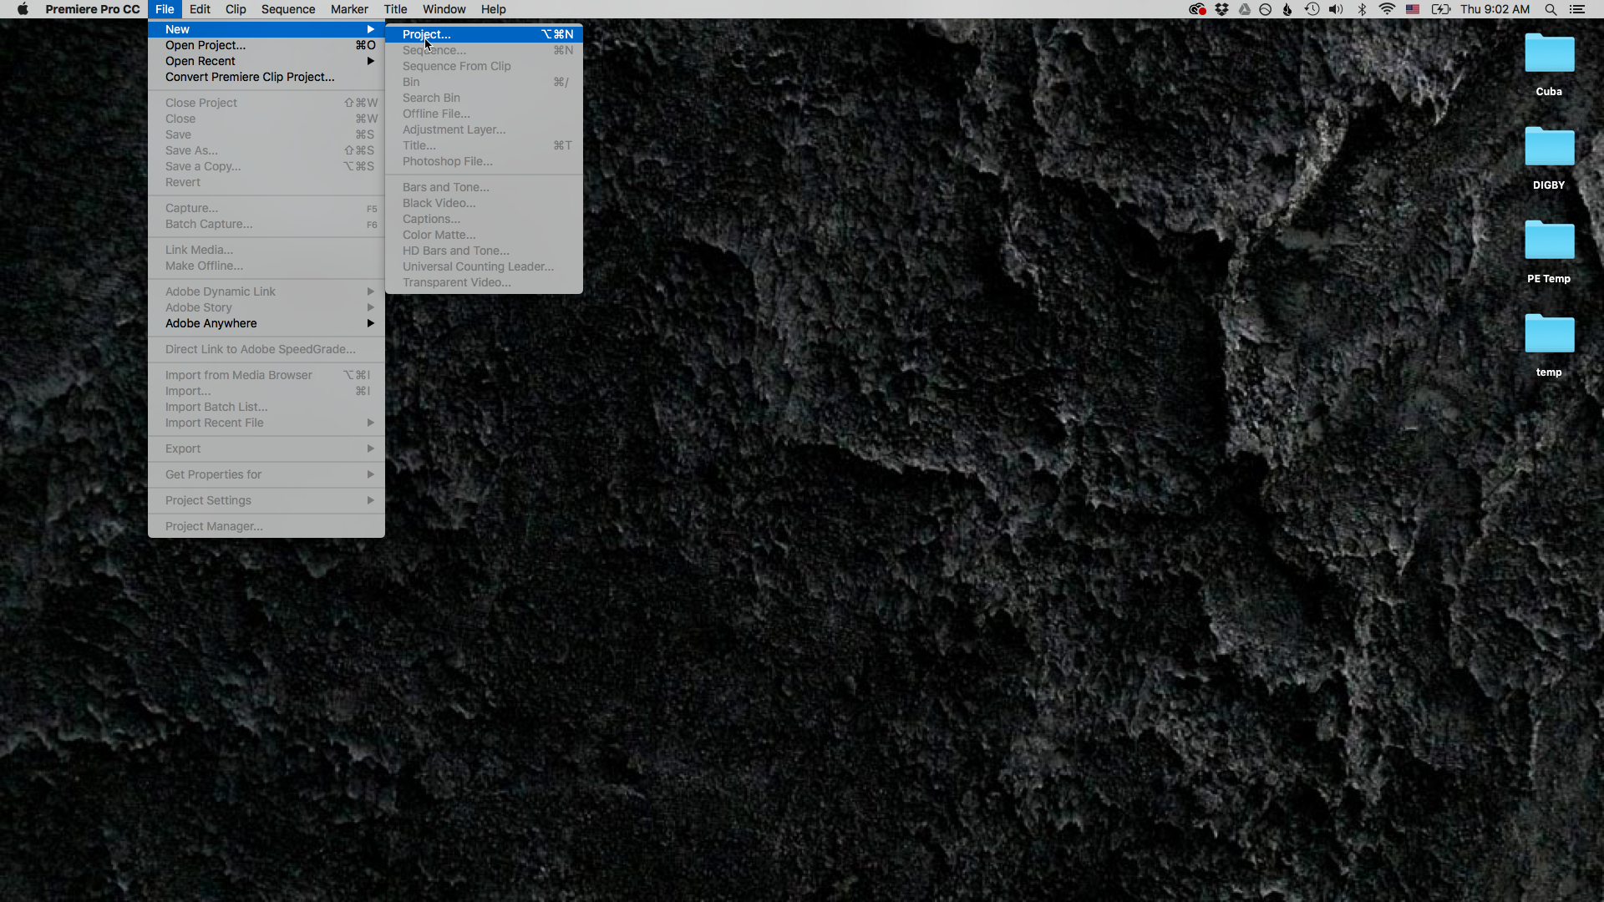
Notes:
Open up New Project

Slide 21
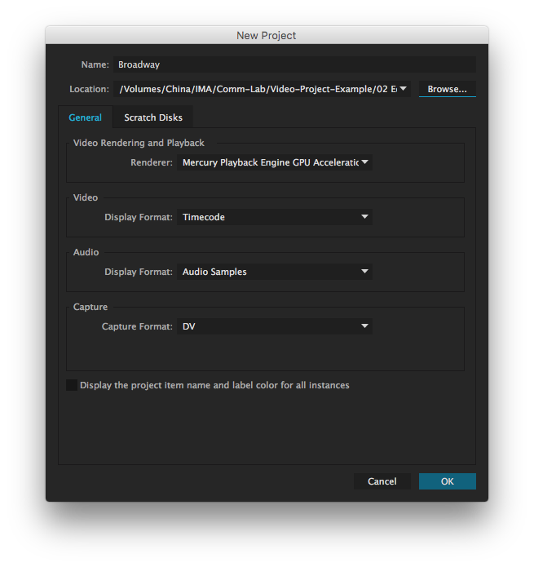
Set Location
Notes:
Set Location: where all of your files will exist

Slide 22
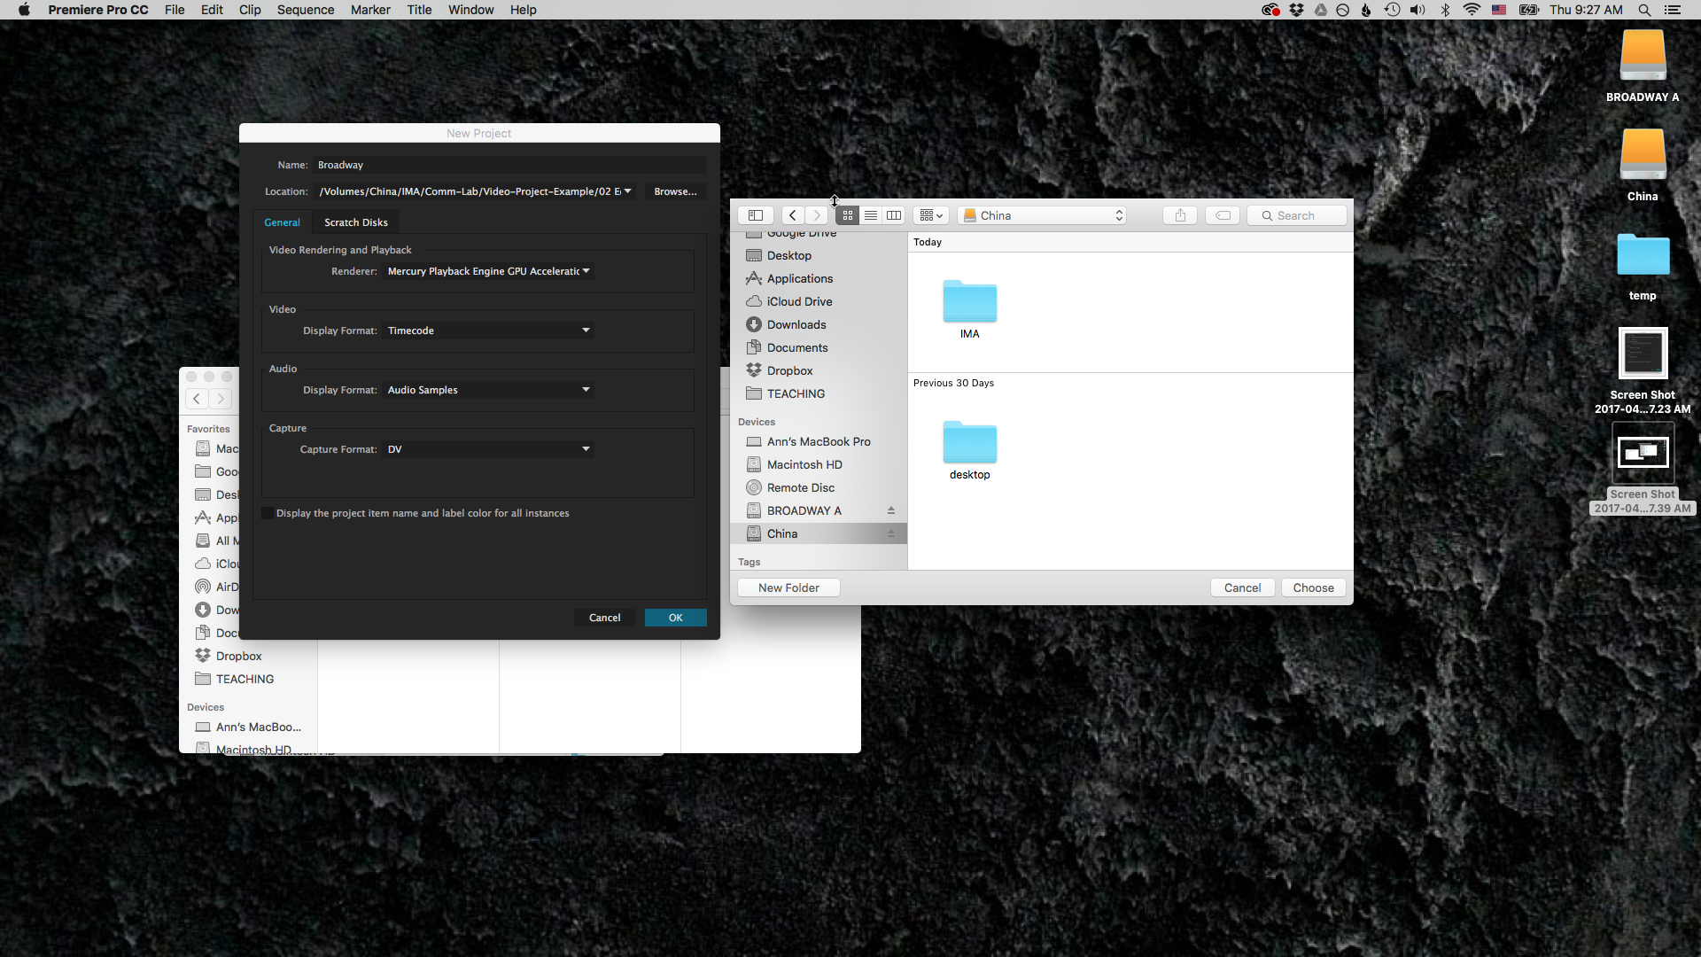

Slide 23
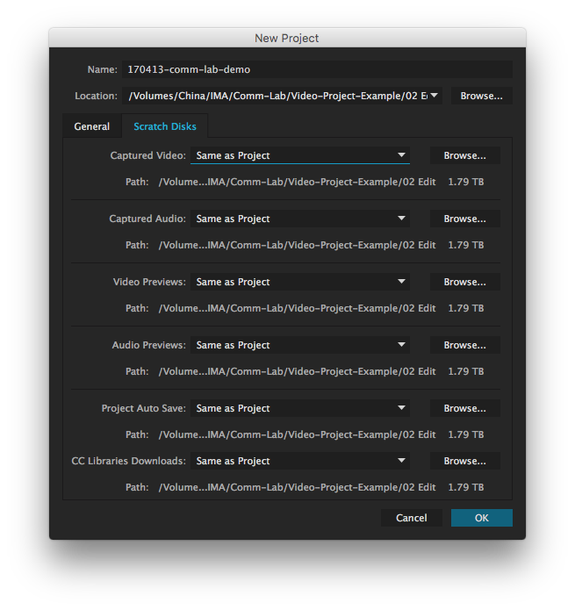

Slide 24
Premiere Workspace

Slide 25
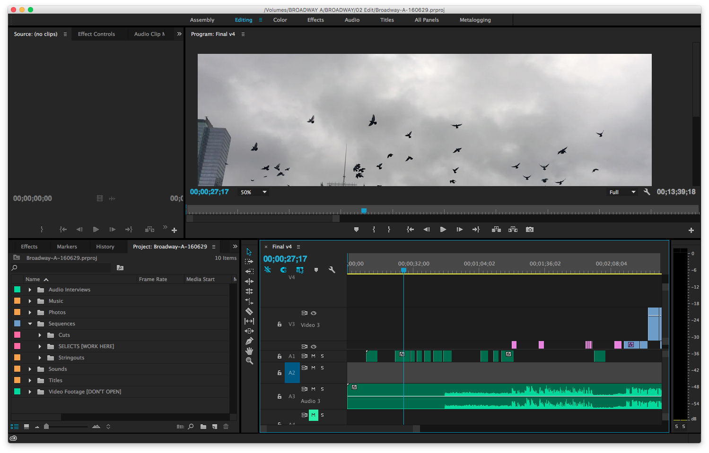
Notes:
So back to the workspace

Slide 26
The Viewer

Slide 27
The Viewer
Timestamp

Slide 28
The Viewer
Total time

Slide 29
Preview

Slide 30
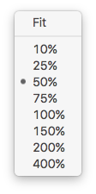
Preview

Slide 31
mark in
mark out

Slide 32
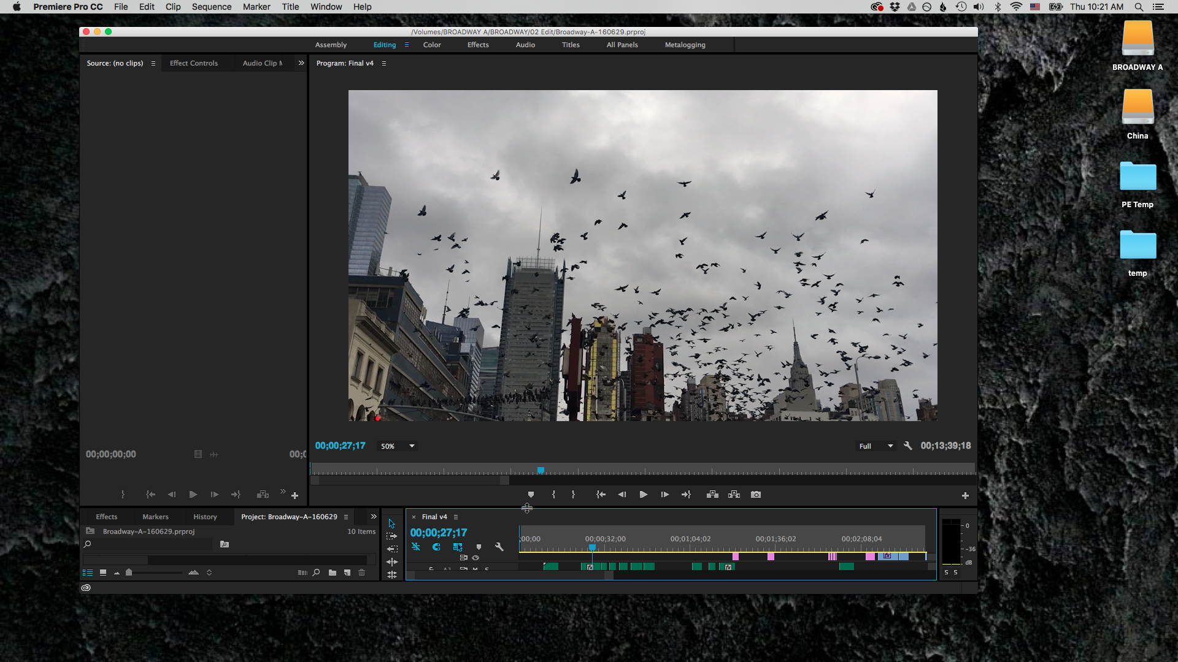
Adjust window size

Slide 33
Change workspace

Slide 34
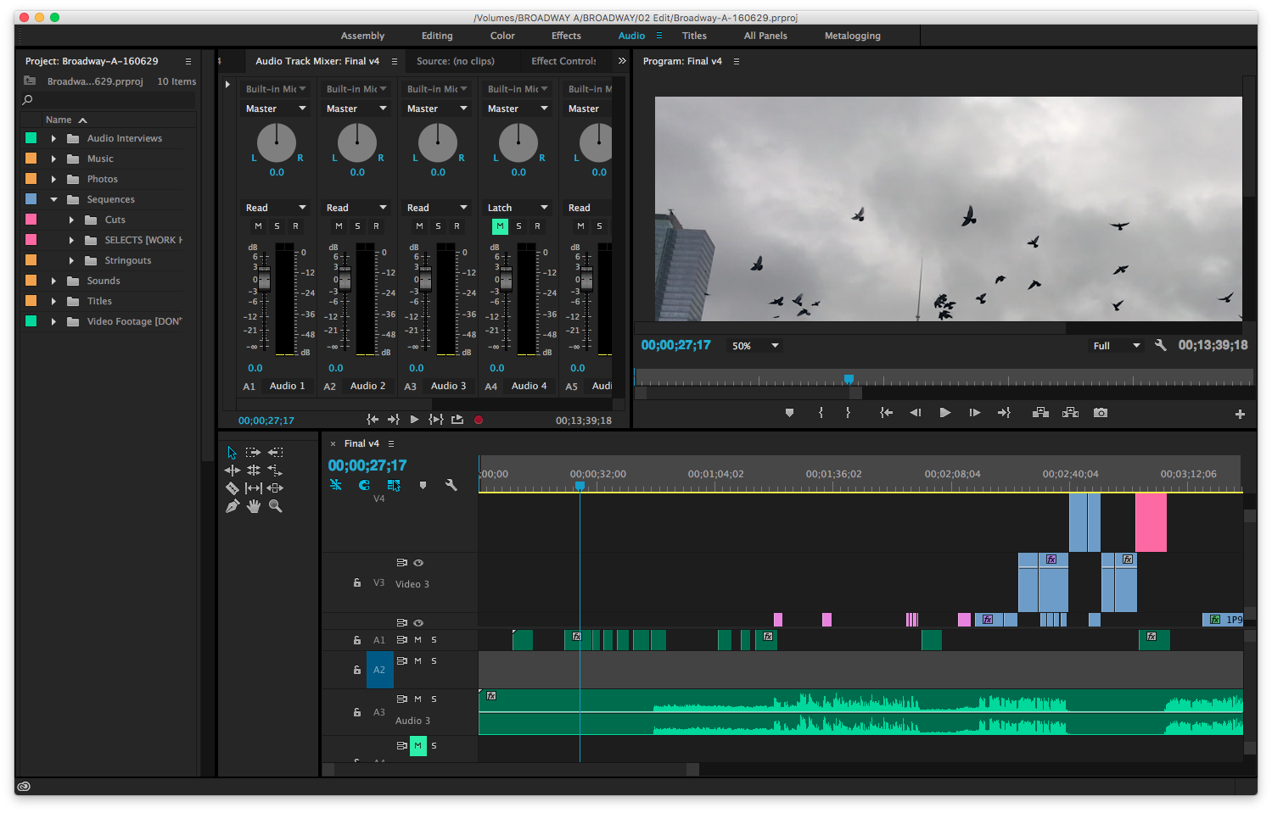
Audio Workspace
Notes:
Changing how your workspace looks

Slide 35
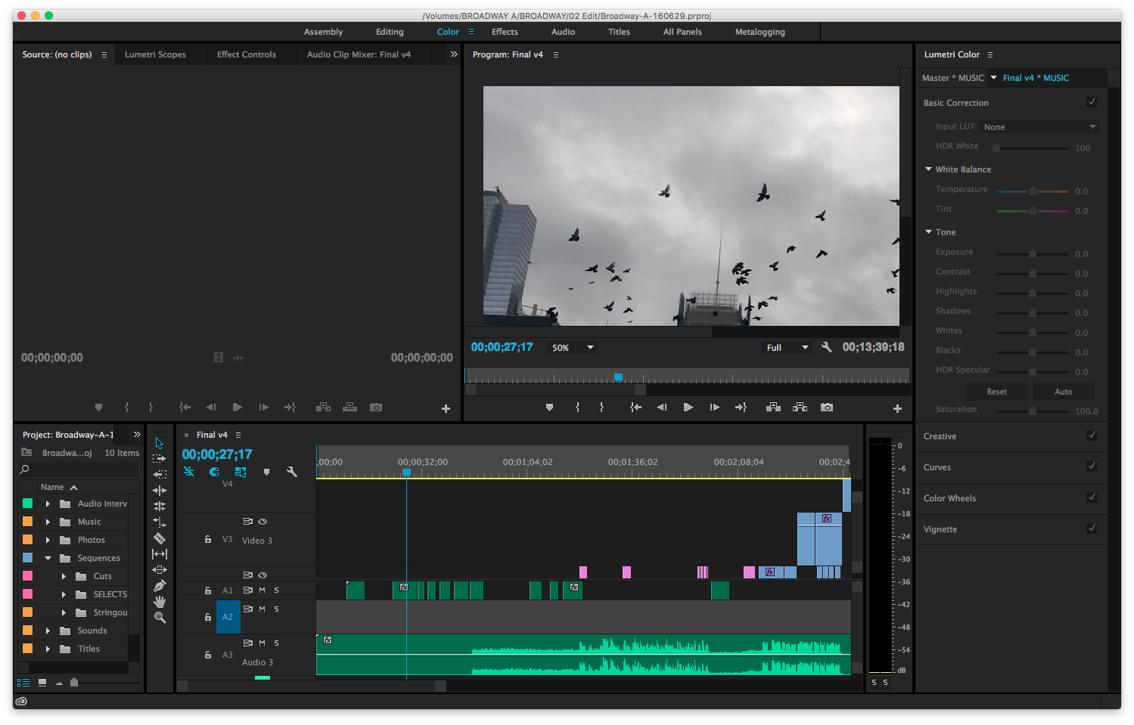
Color Workspace
Notes:
Changing how your workspace looks

Slide 36
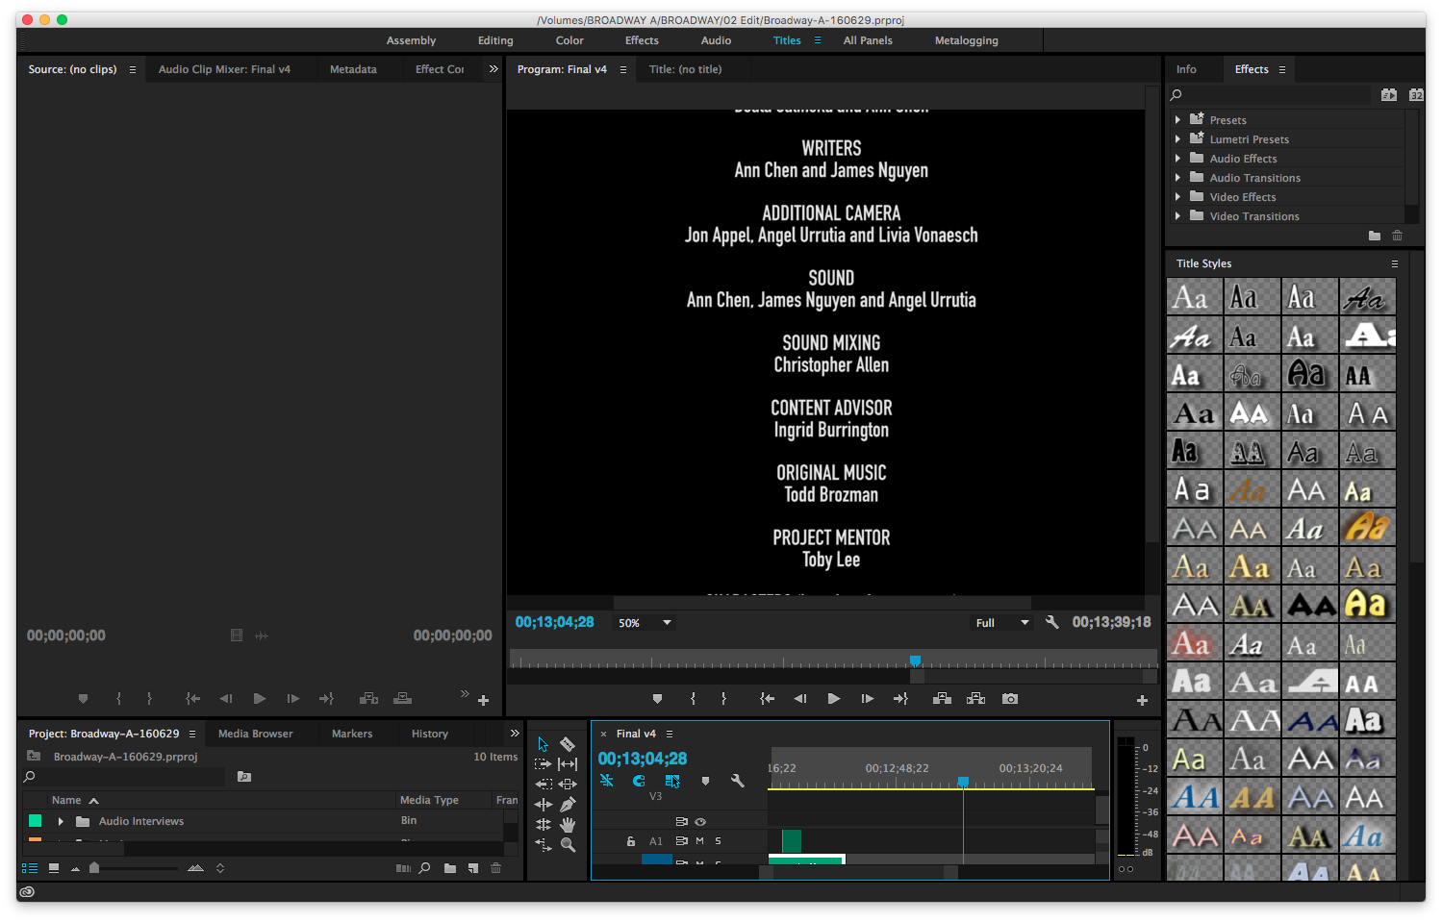
Titles Workspace
Notes:
Changing how your workspace looks

Slide 37
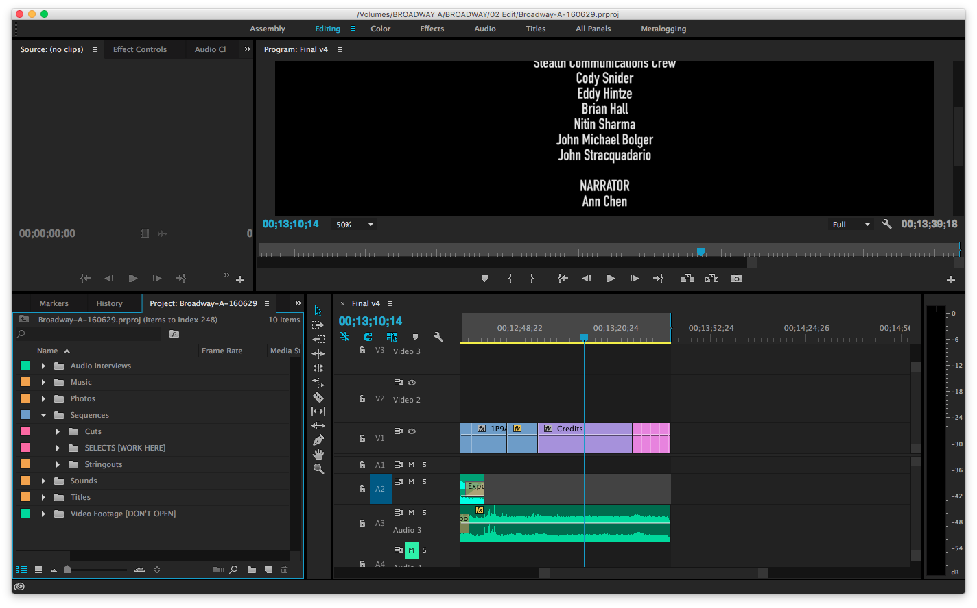
Bins

Slide 38
Bins
Put footage in here

Slide 39
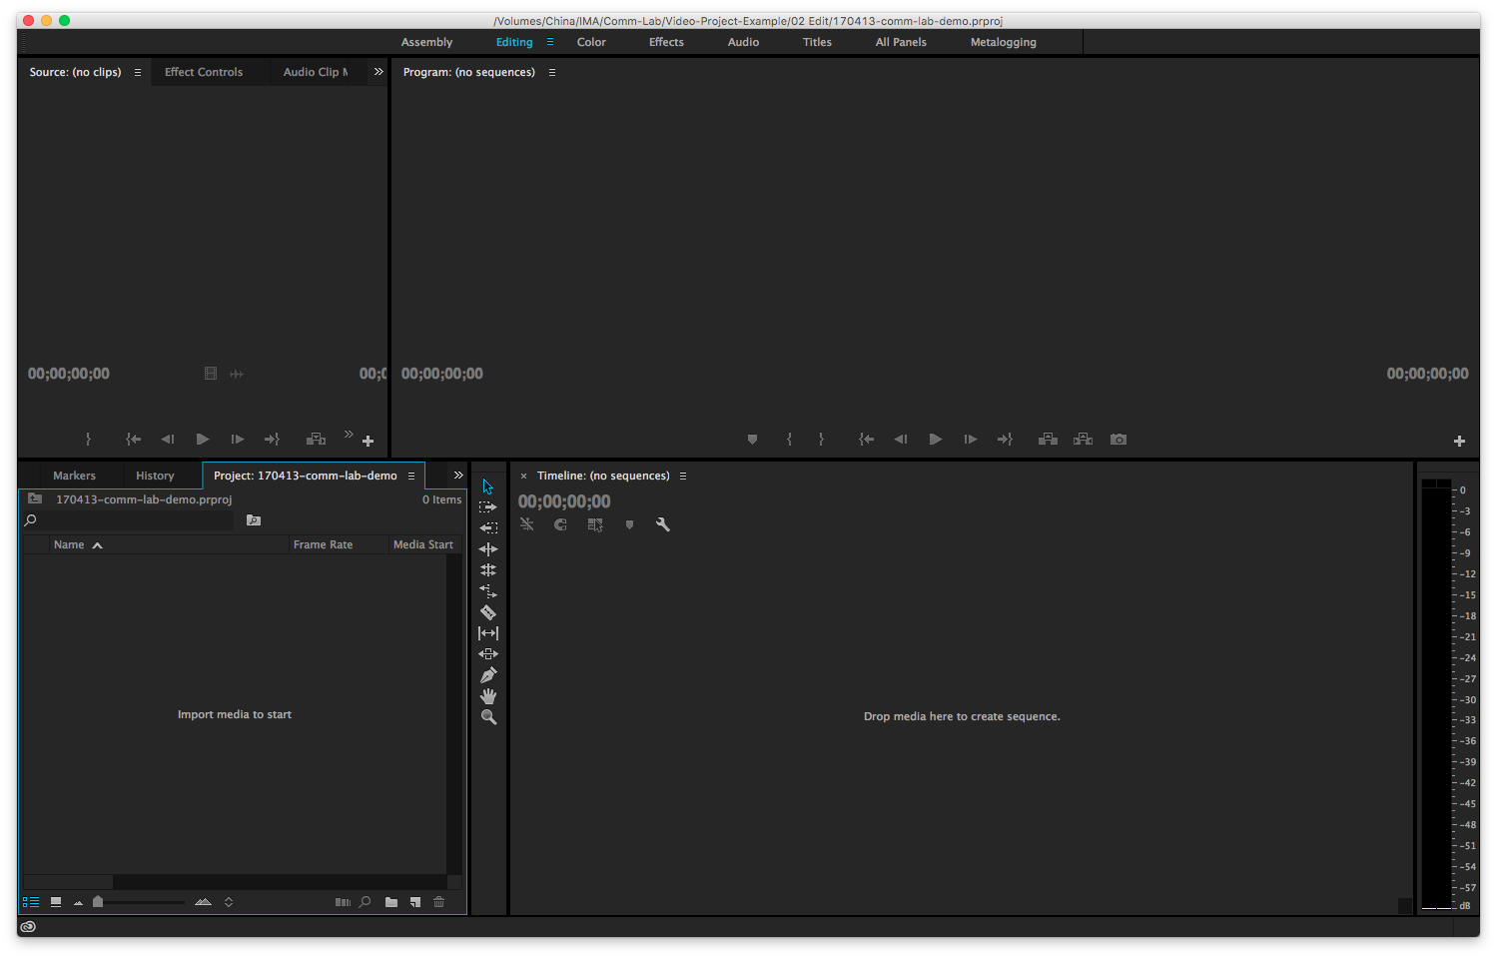

Slide 41
New Bin

Slide 42
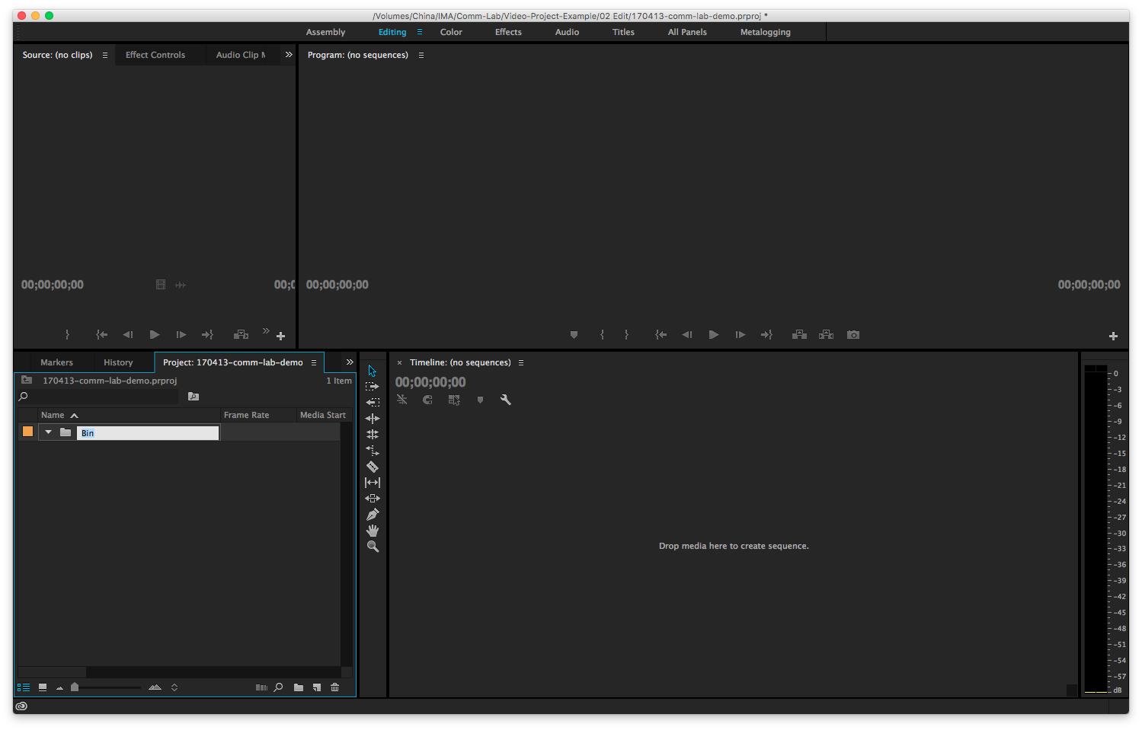

Slide 43
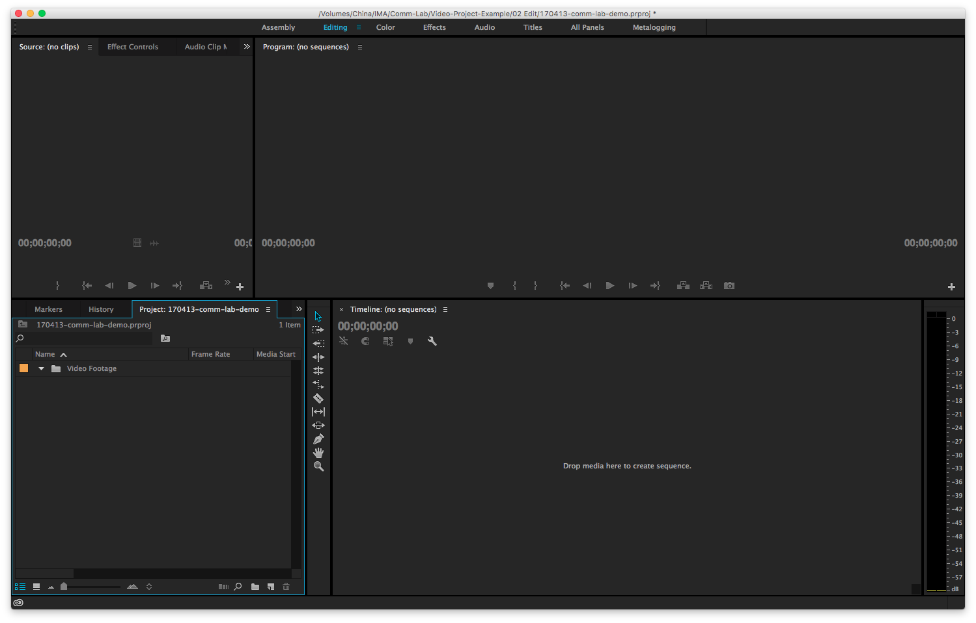

Slide 44
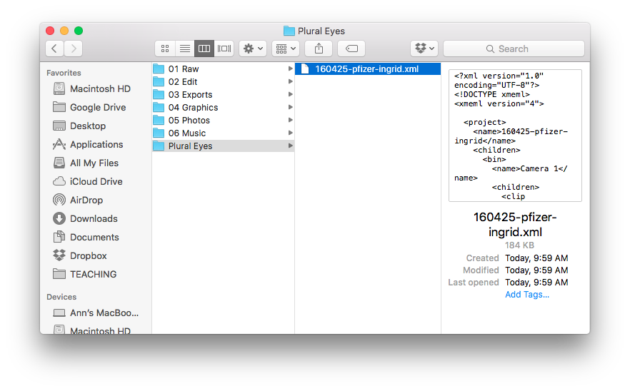

Slide 46
Drag into Video Footage Bin

Slide 47
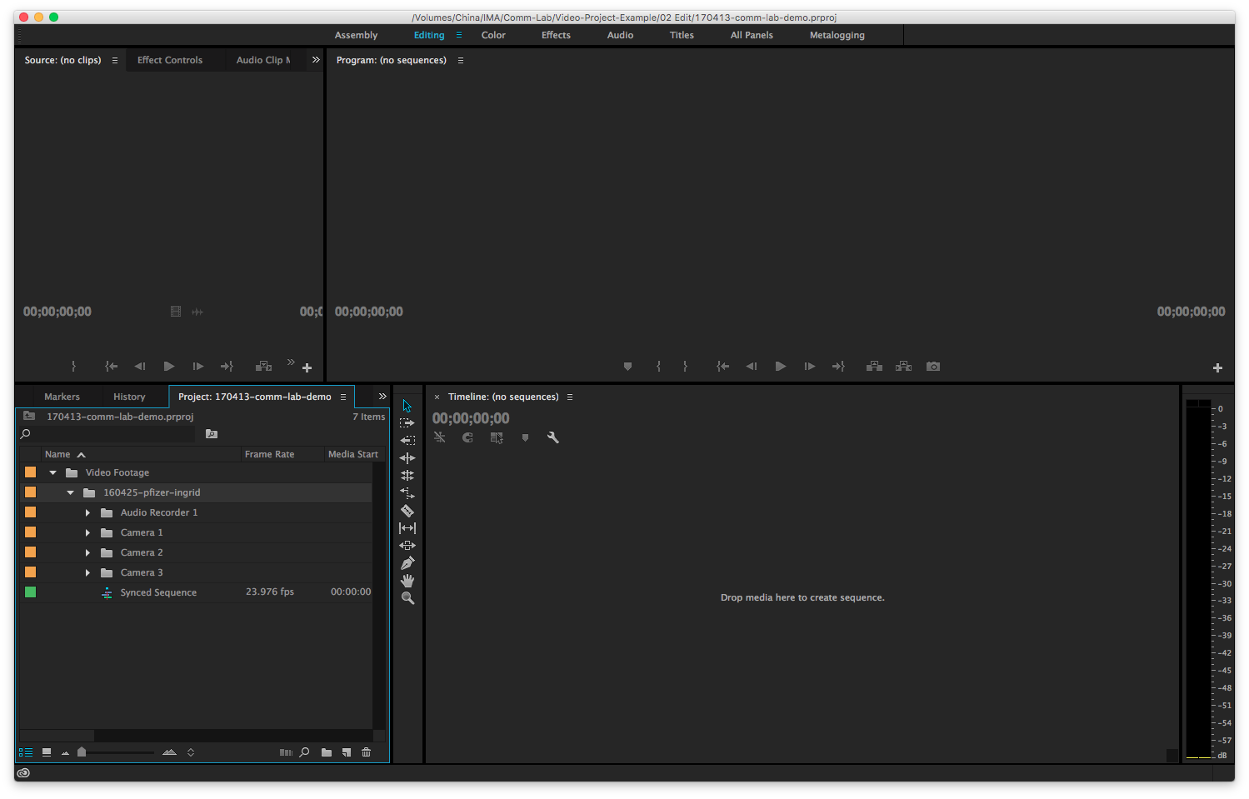

Slide 48
Make a copy

Slide 49
Ctl + c, Ctl + v

Slide 50
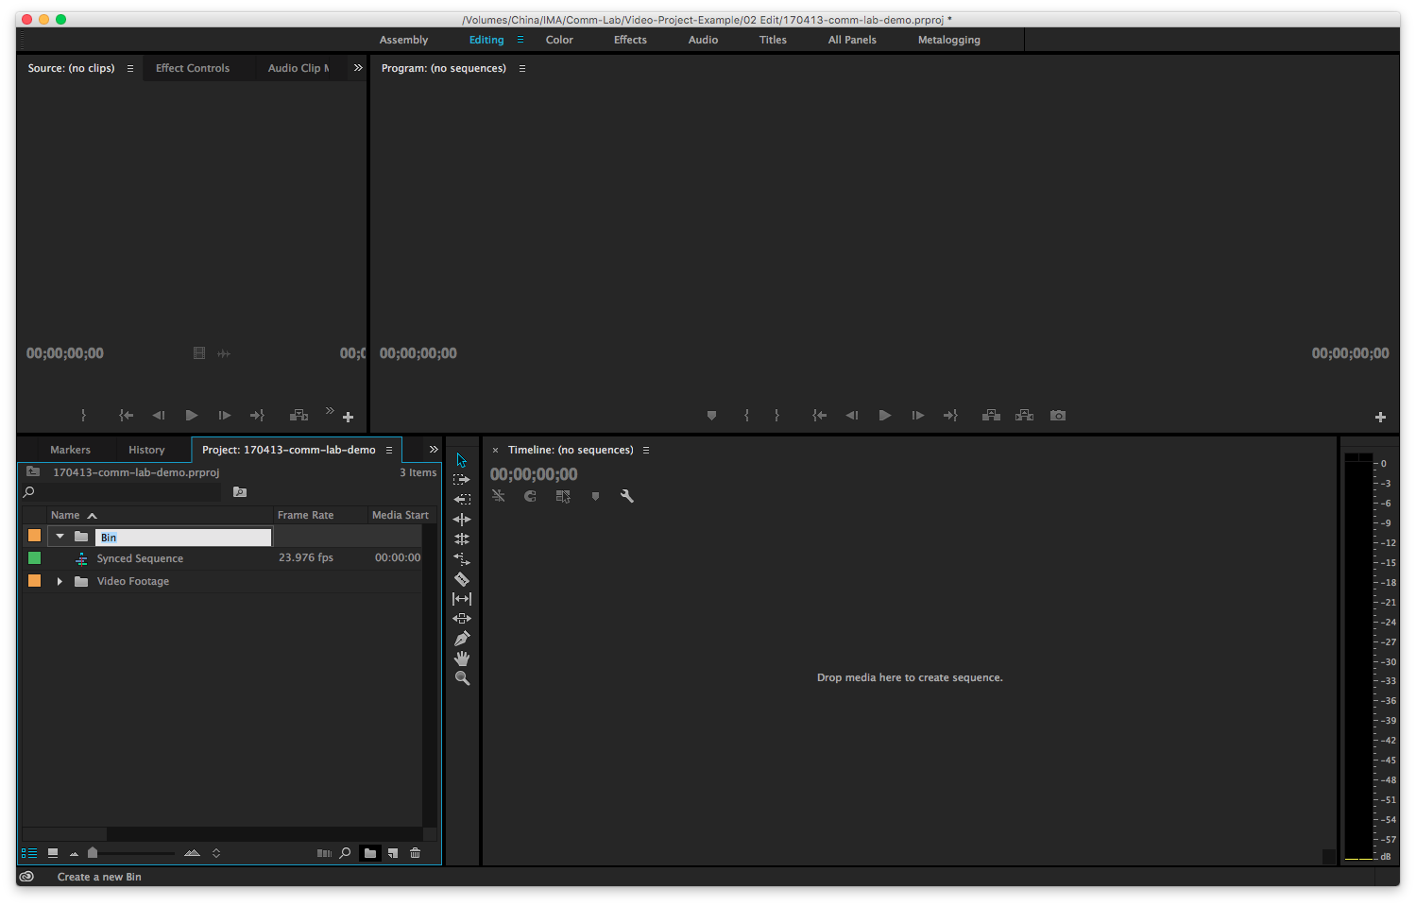
New Bin

Slide 51
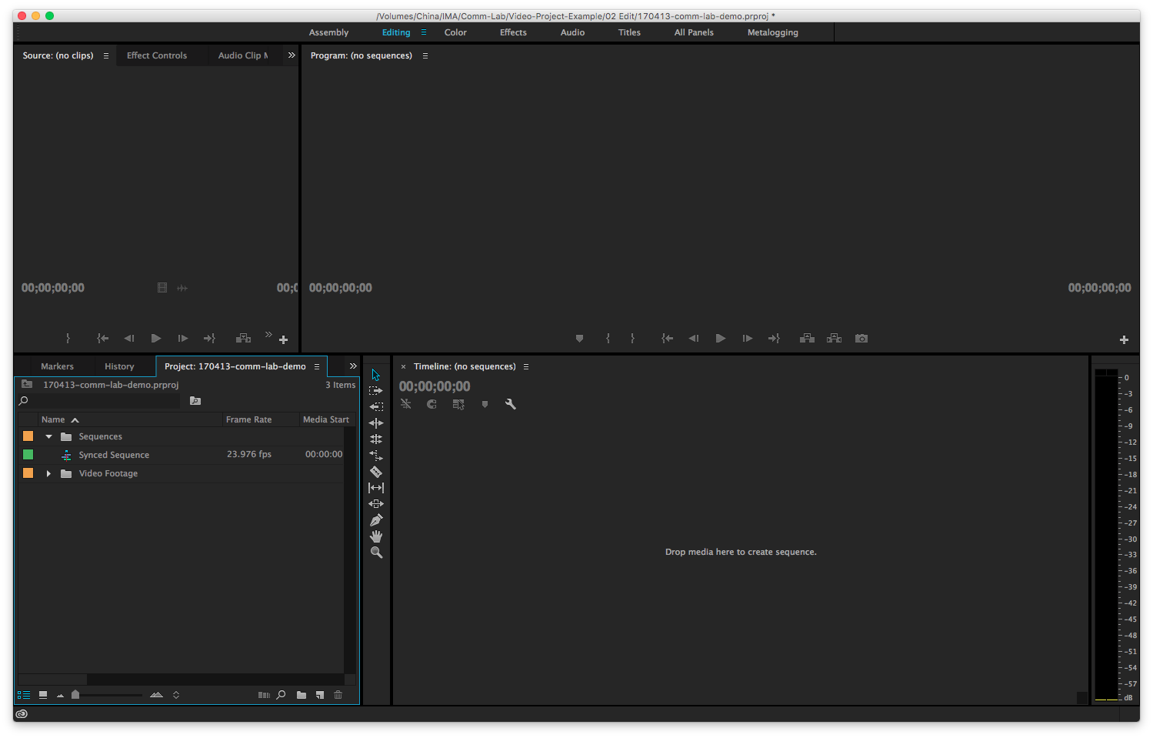
Sequences
New Bin
Notes:
Create new bin called Sequences

Slide 52
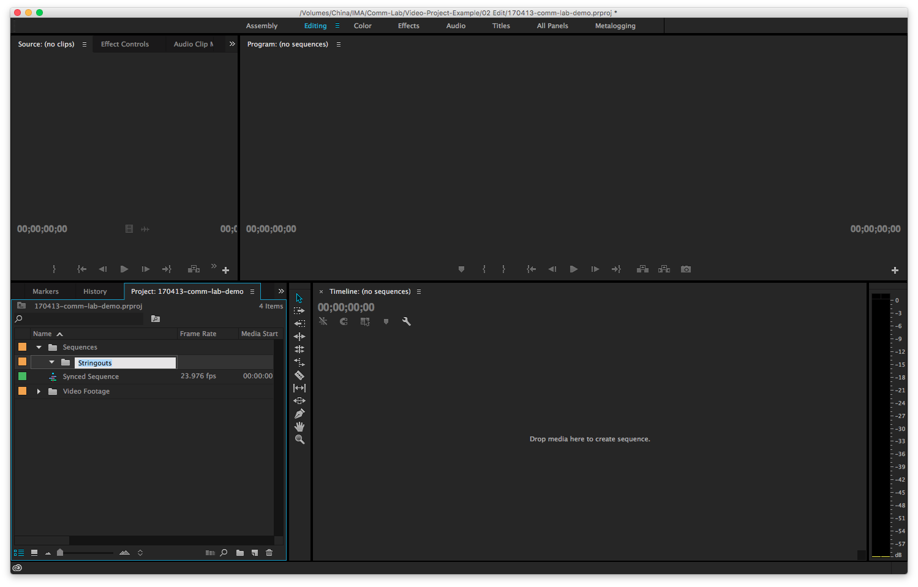
Stringouts
New Bin
Notes:
New bin Stringouts nestled in Sequences. Stringout is basically your raw footage, the entire length of it. You can watch your footage in here.

Slide 53
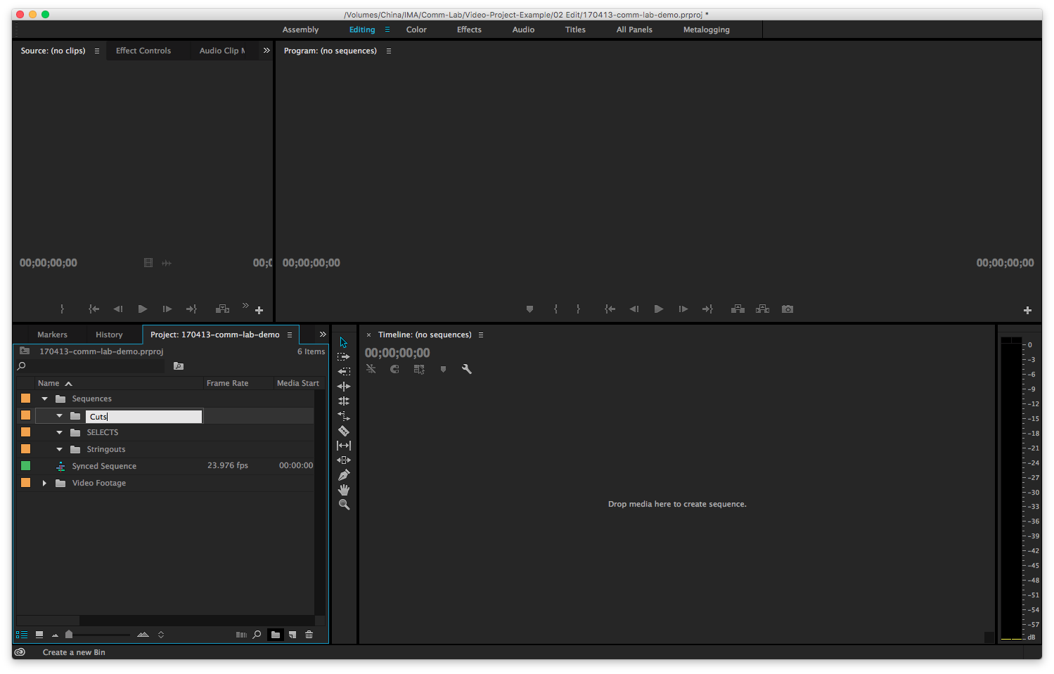
Cuts/Edits
New Bin
Notes:
Final bin, called Cuts or Edits. This is where you can start placing your work in progress cuts that will become your eventual film.

Slide 54
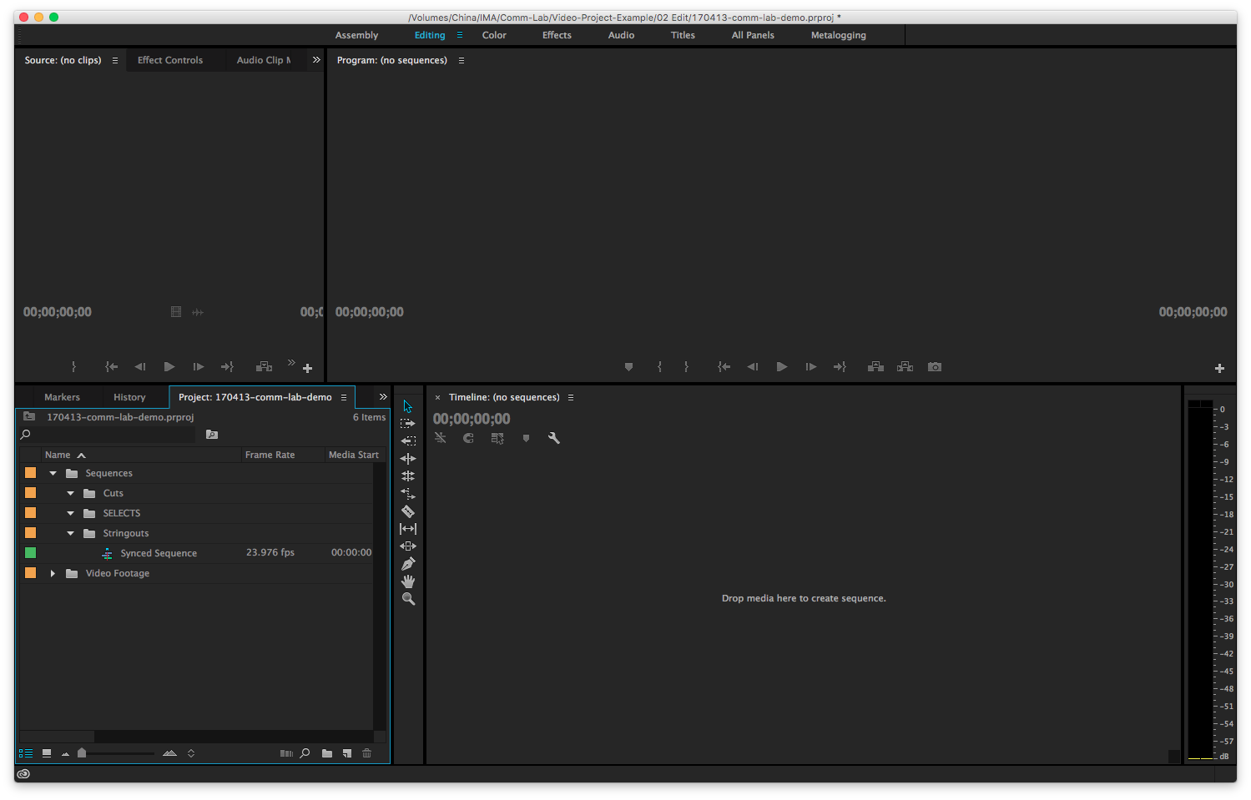
Move into Stringouts folder

Slide 55
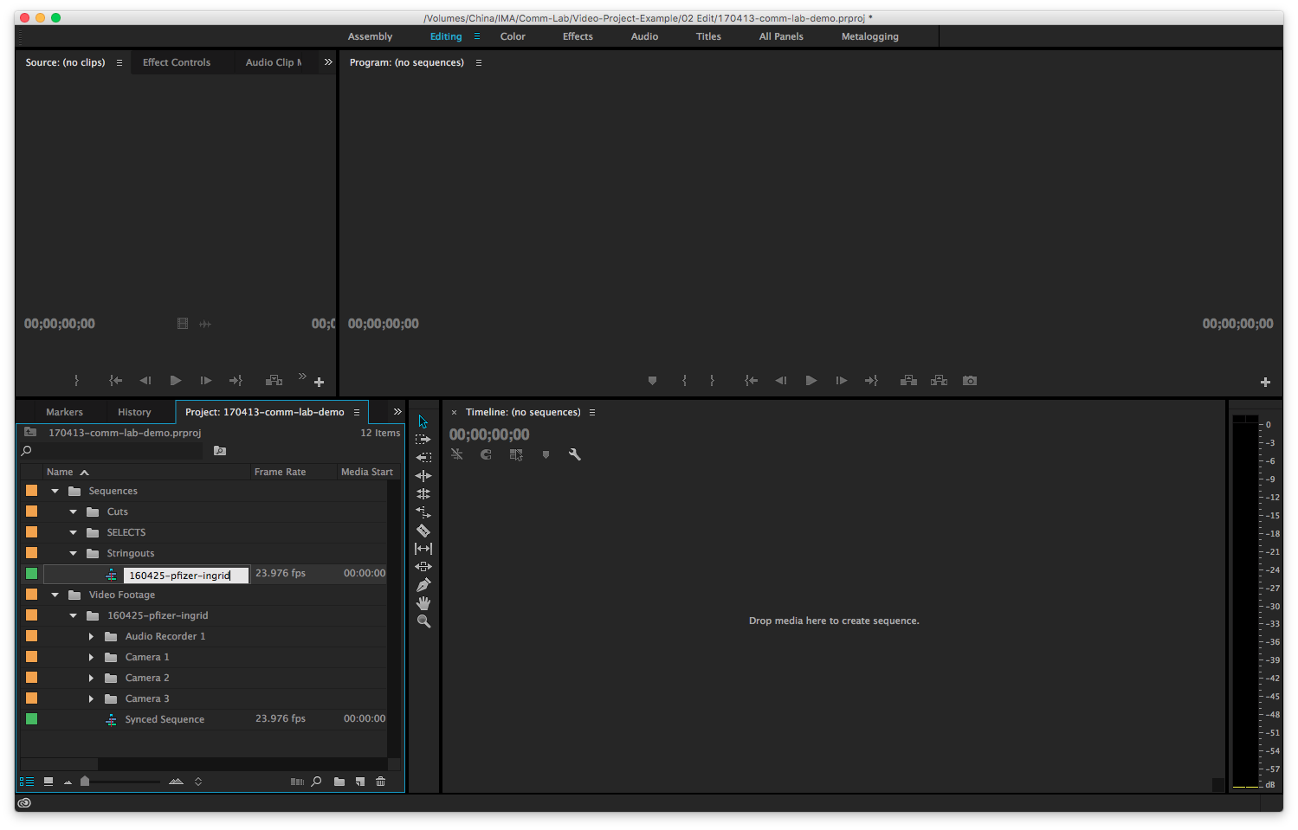
Rename sequence

Slide 56
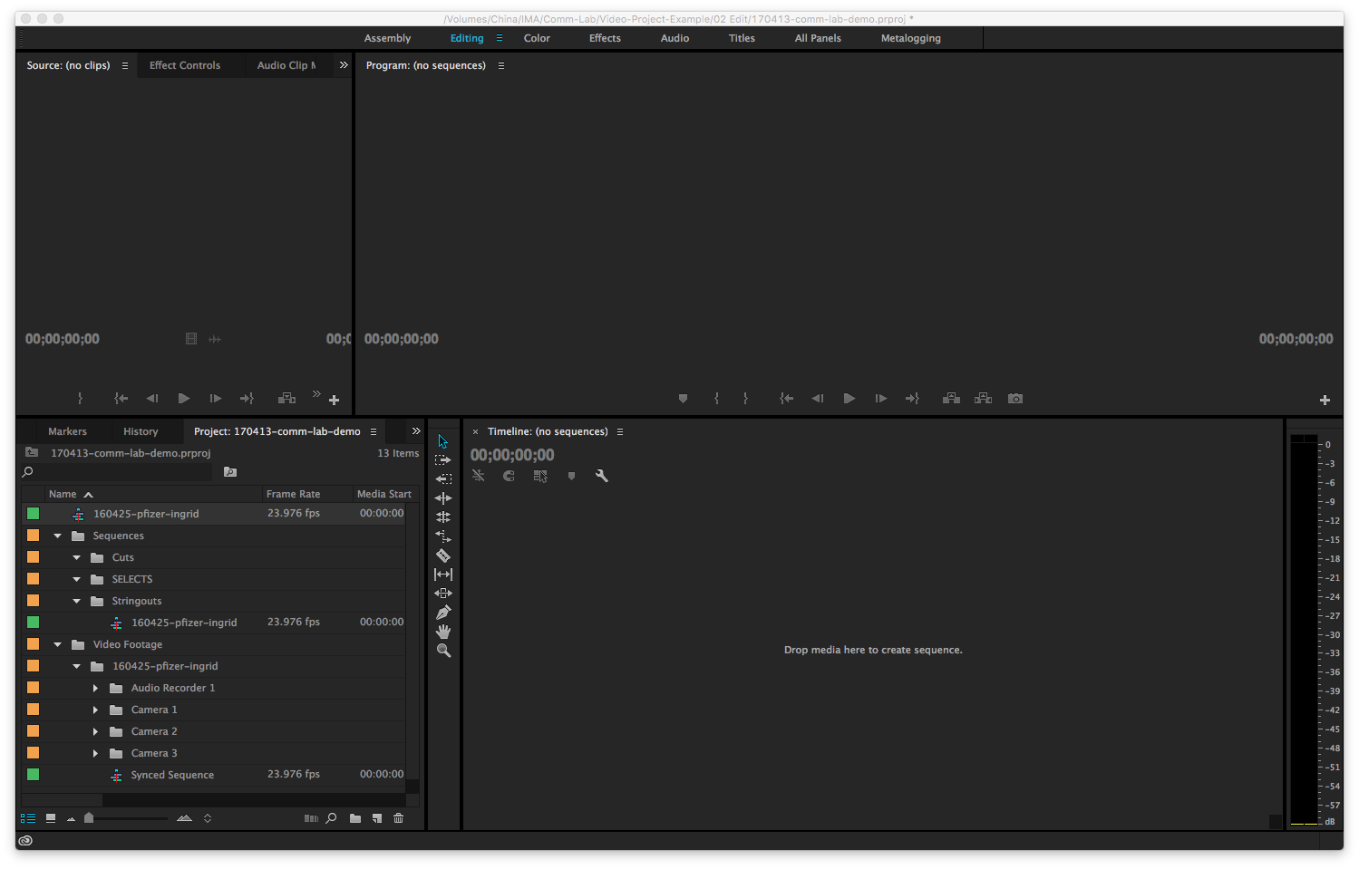
Make a copy of sequence

Slide 57
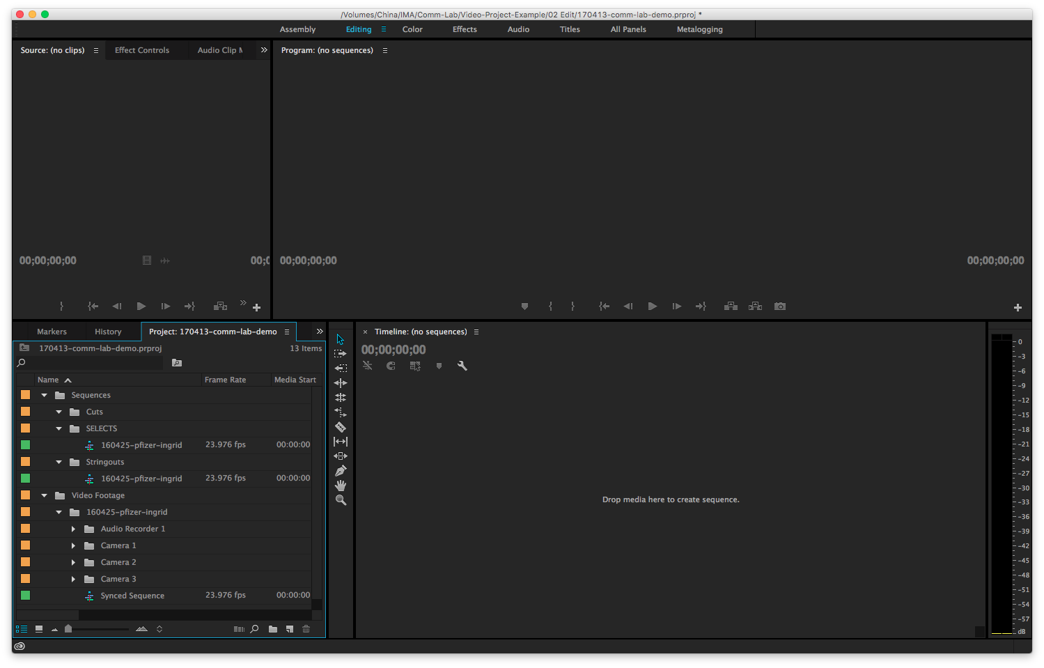
Move into Selects folder

Slide 58
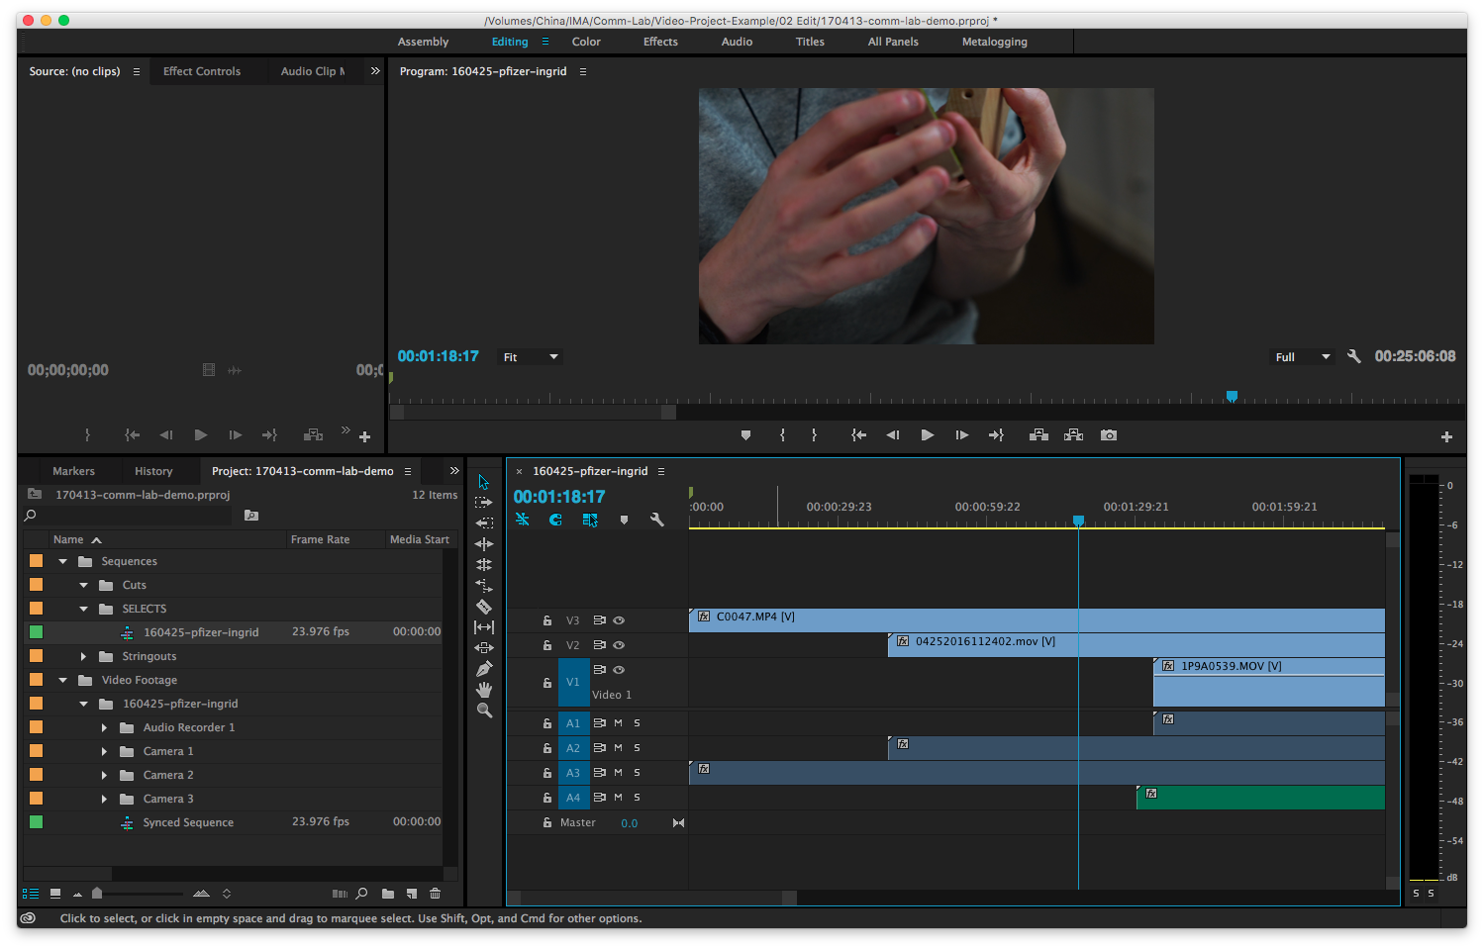
Make selections in here

Slide 59
The Timeline
Drag and drop clips in here

Slide 60
Stacking Clips
Extra tracks are created automatically.

Slide 61
Only top clips are visible.
All audio plays at once. Mute/unmute channels.
Stacking Clips

Slide 62
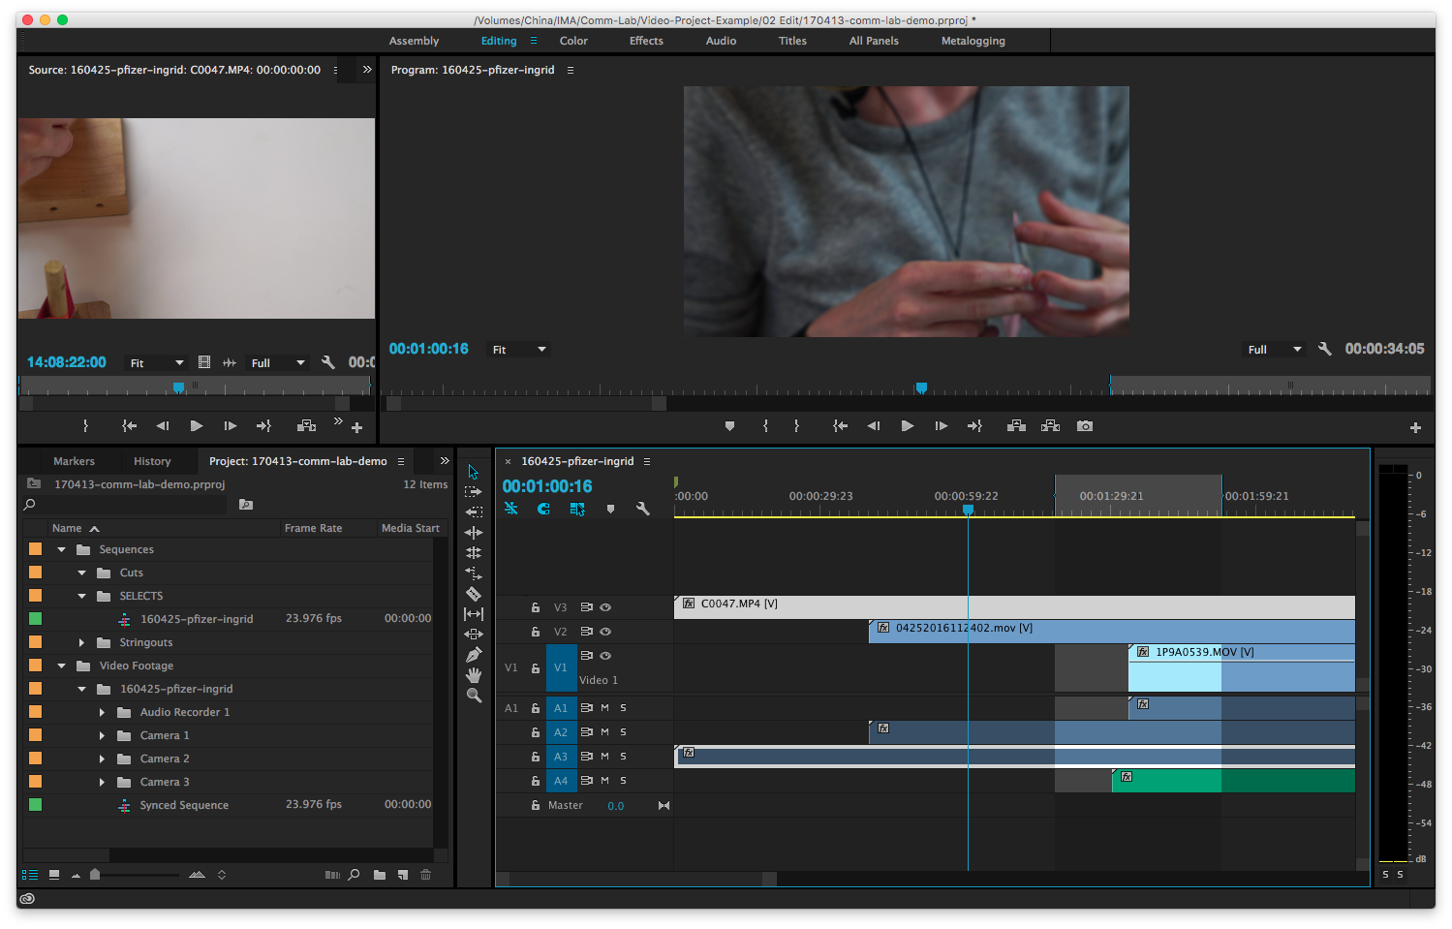
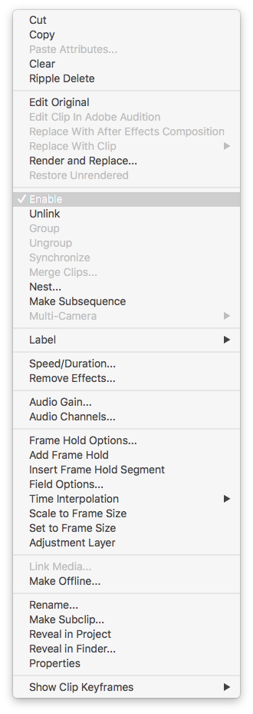
Enable & Disable Clips
To disable entire clip (including audio).
Right click on track

Slide 63
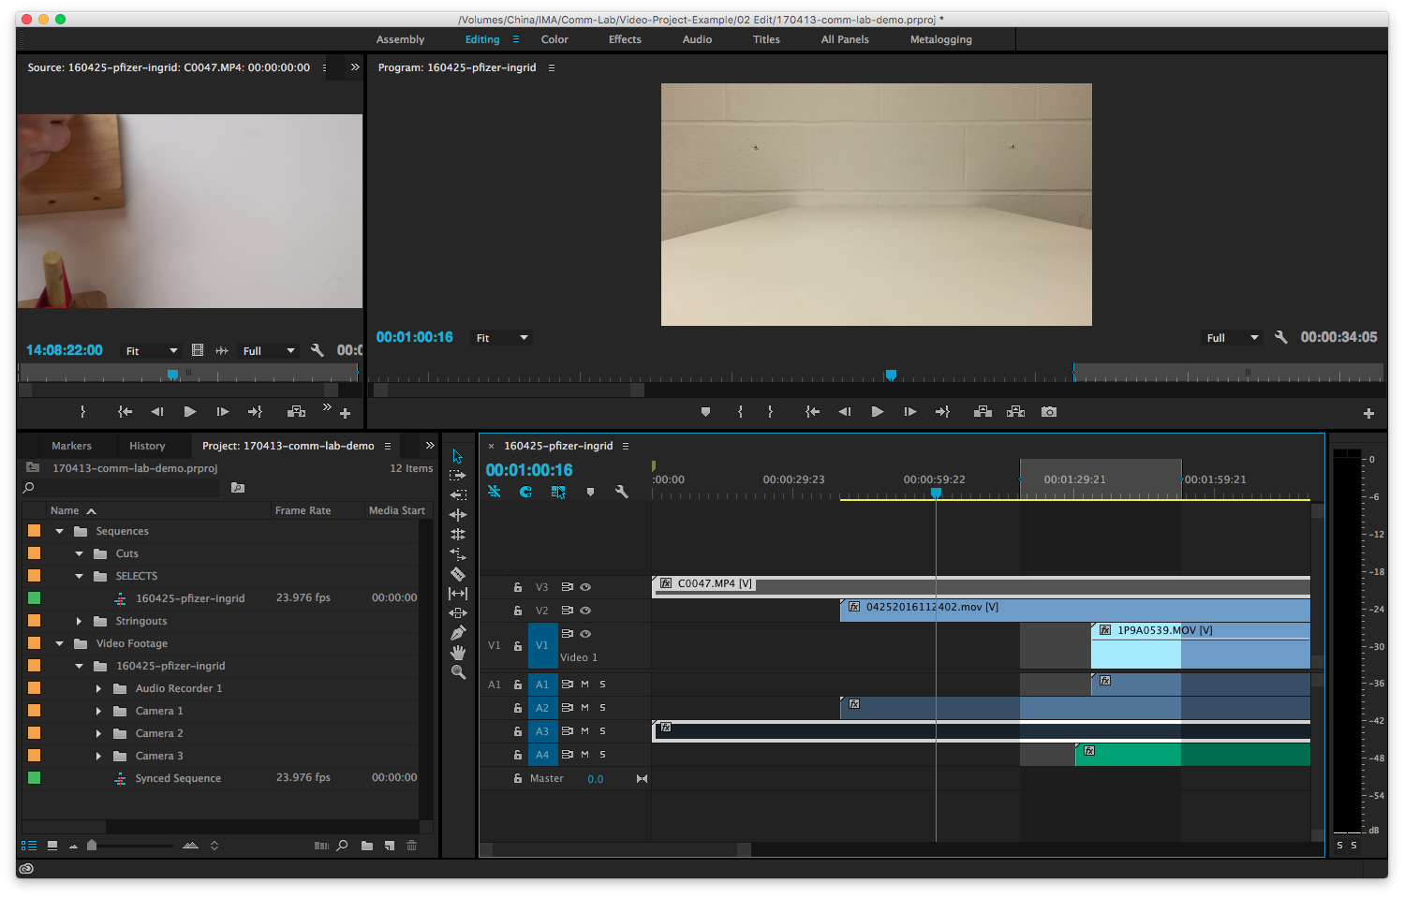
Both audio & video disabled

Slide 64
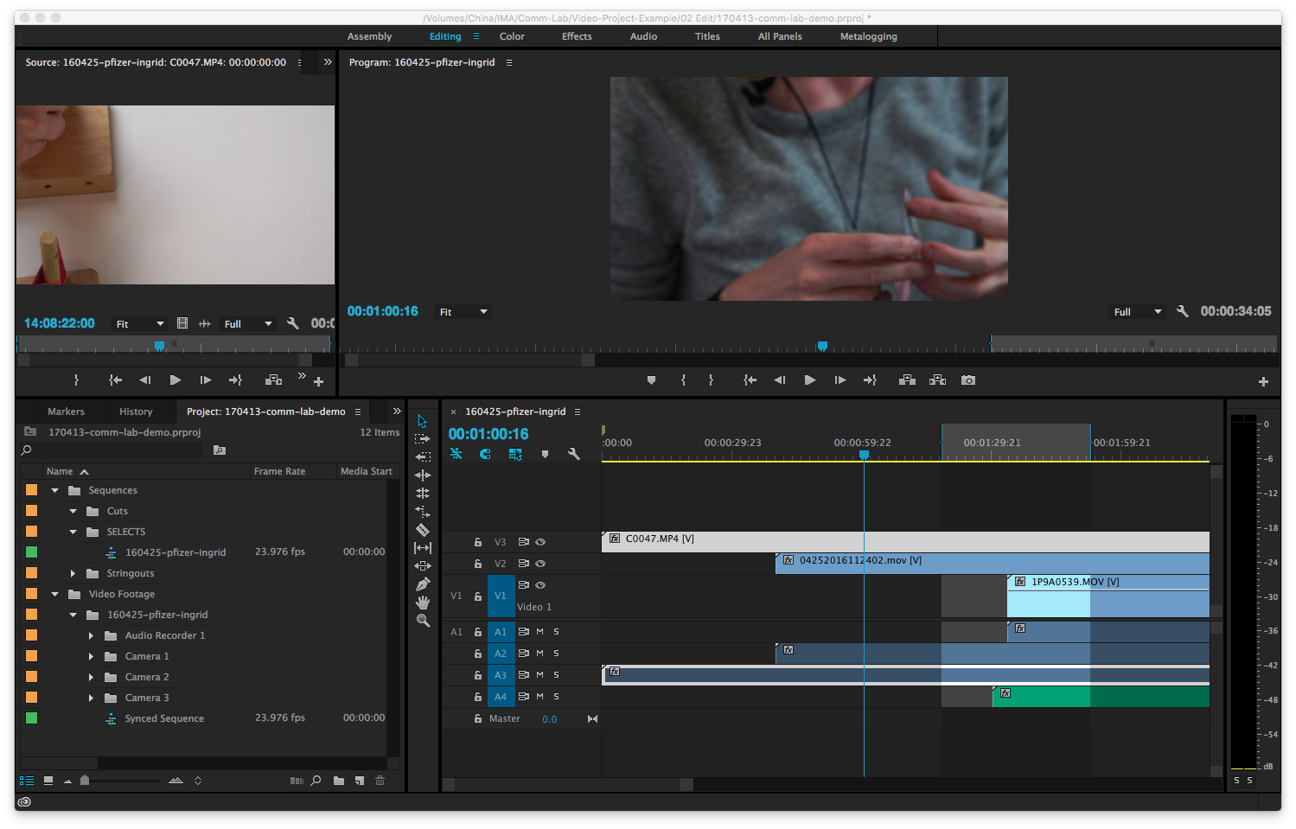

Slide 65
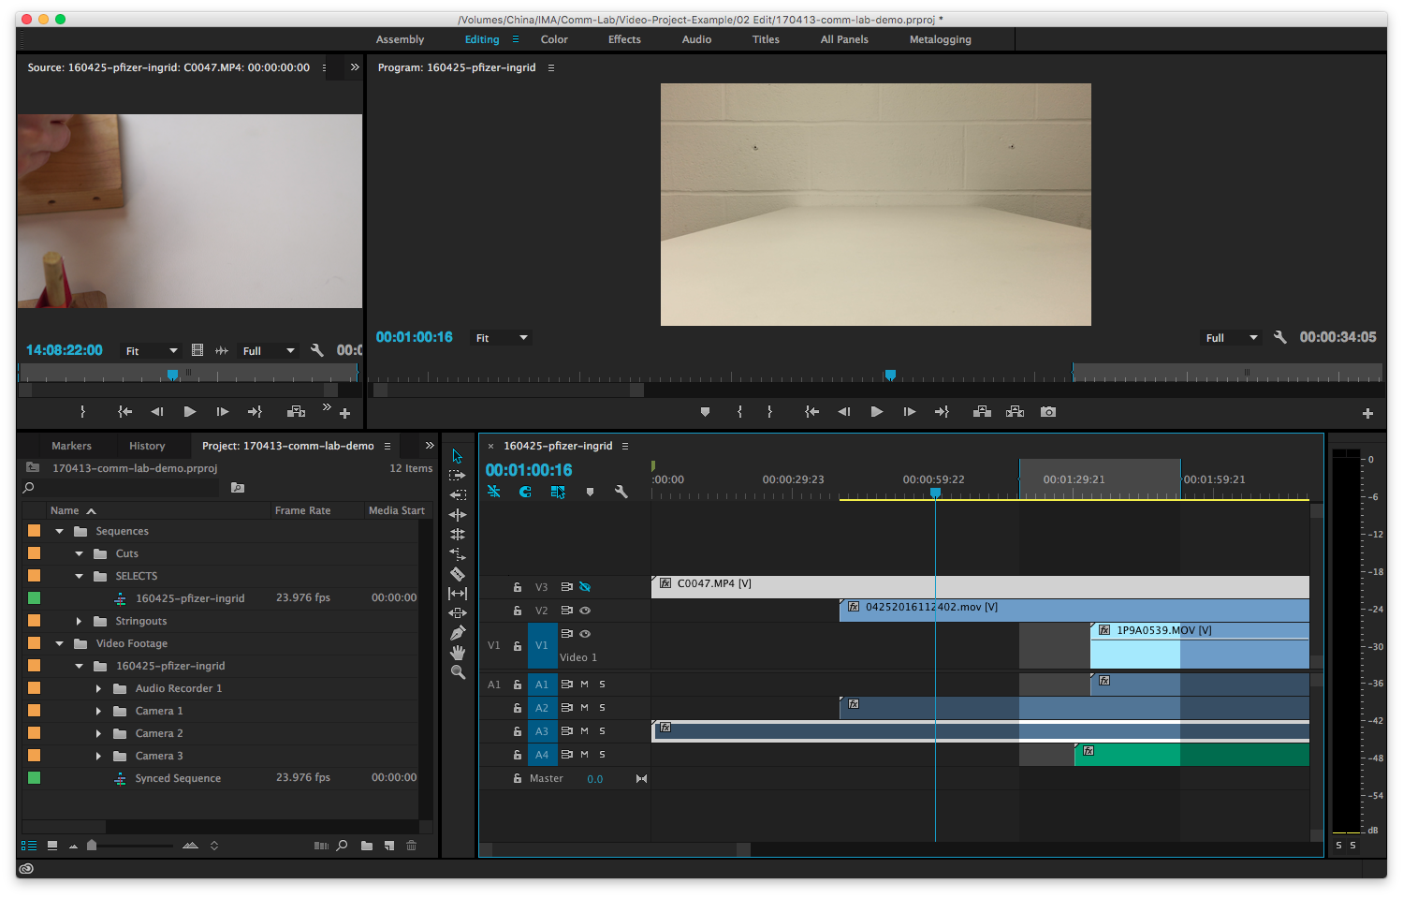

Slide 66
Tool Bar

Slide 67
Razor Tool
For cutting clips

Slide 68
Track select forward / backward

Slide 69
Slip Edit
Changes time but not length of clip.
Good for minute changes at beginning and ends of clips.

Slide 70
Slide Edit
Moves clip left and right on timeline.
Other clips adjust time to compensate.

Slide 71

Unlink/Link Audio & Video
If you want to edit the video and audio separately
Notes:
You probably won’t work with this that much in this context. You aren’t too concerned about the length of the project.

Slide 72
Snapping the Playhead
Magnet icon is blue (on) to snap playhead to the ends of clips. Click to turn off.
Notes:
You probably won’t work with this that much in this context. You aren’t too concerned about the length of the project.

Slide 73
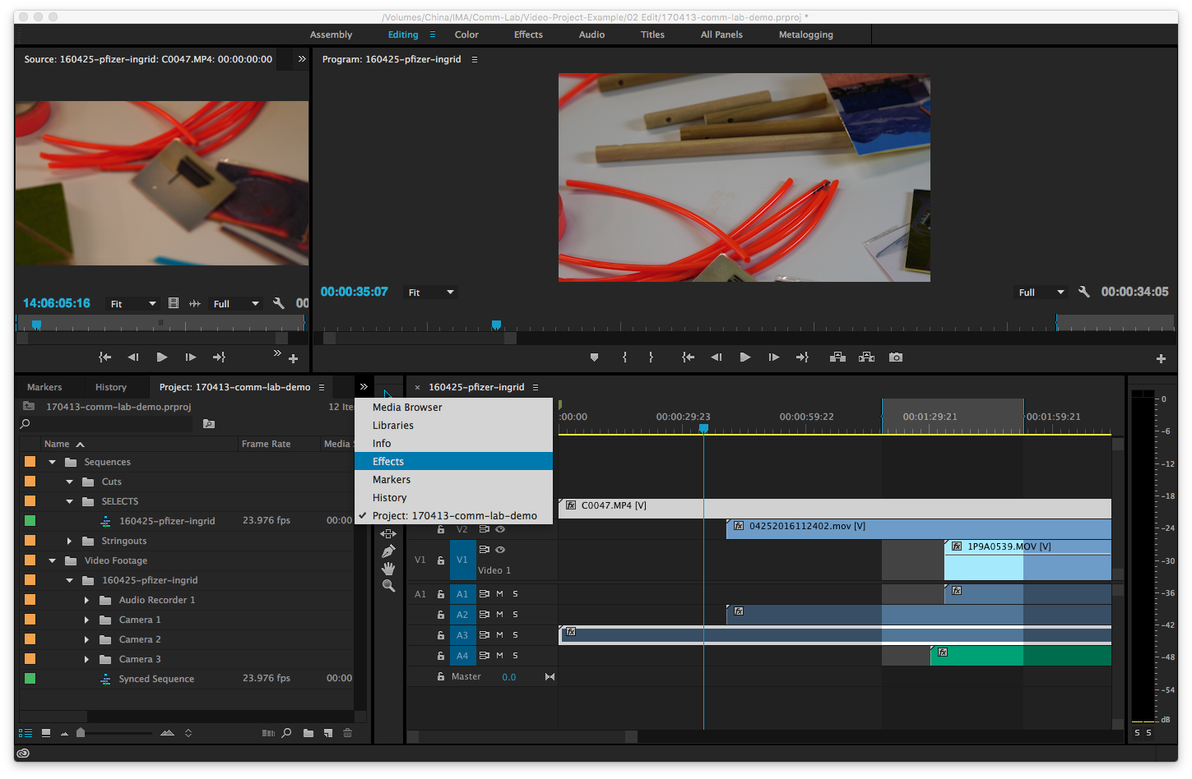
Effect - Transitions
Notes:
You probably won’t work with this that much in this context. You aren’t too concerned about the length of the project.

Slide 74
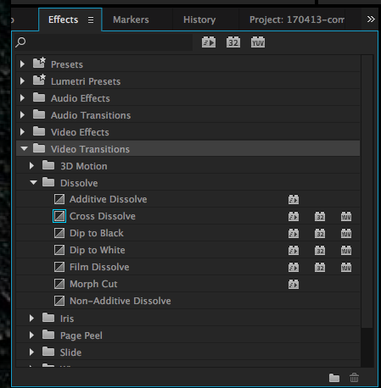
Select Video Transitions > Dissolve
Select a transition. Drag onto clip.

Slide 75
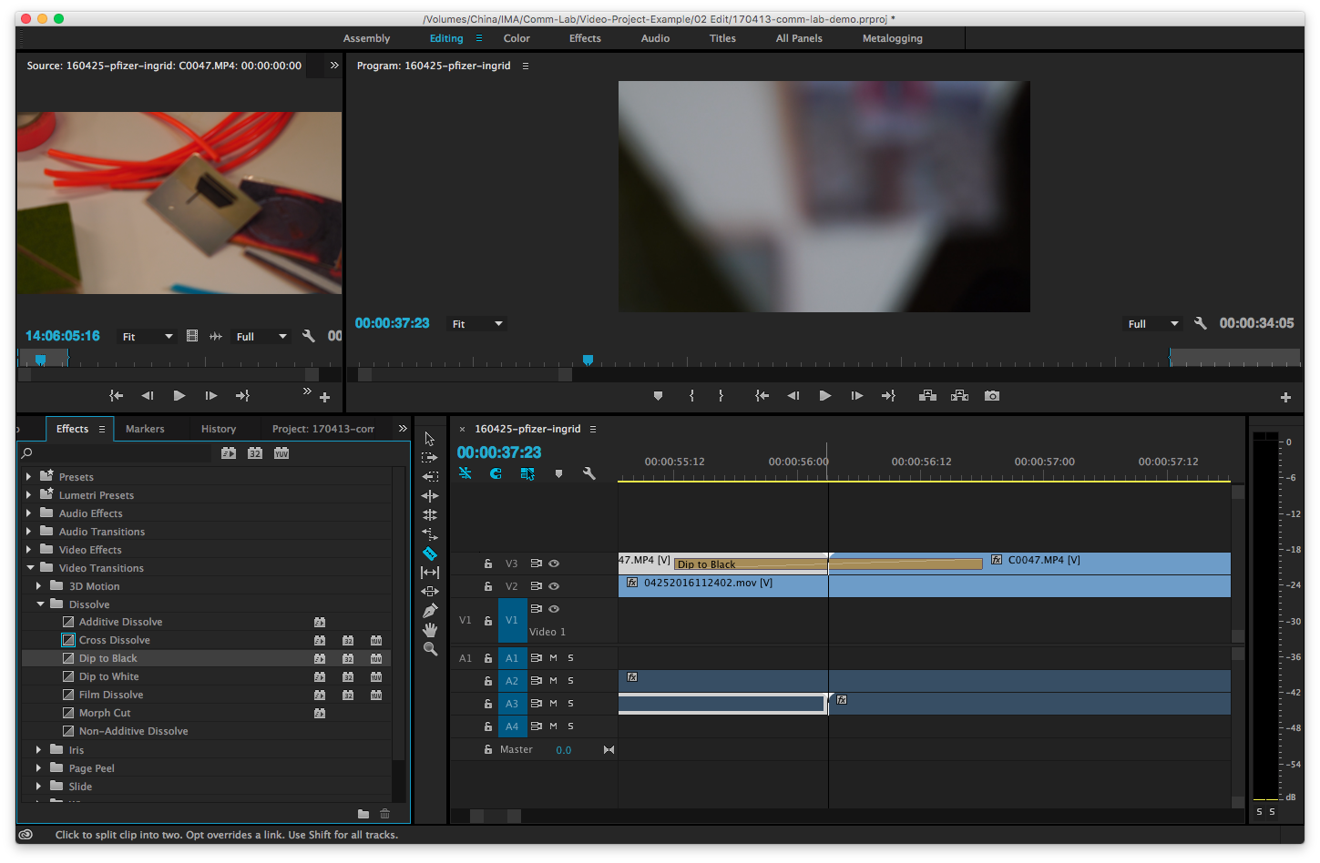
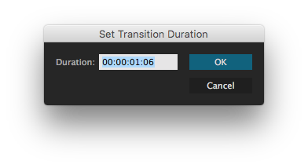
Double click on transition to change duration.

Slide 76
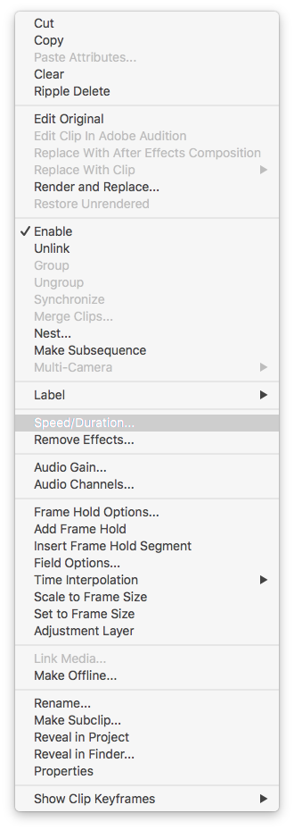
Speed & Duration
Right click on clip.
Notes:
You probably won’t work with this that much in this context. You aren’t too concerned about the length of the project.

Slide 77
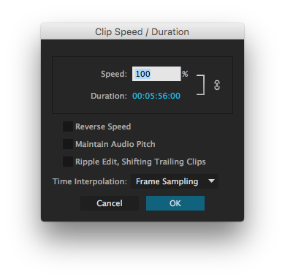
Speed & Duration
Speed up or slow down the clip.
Notes:
You probably won’t work with this that much in this context. You aren’t too concerned about the length of the project.

Slide 78
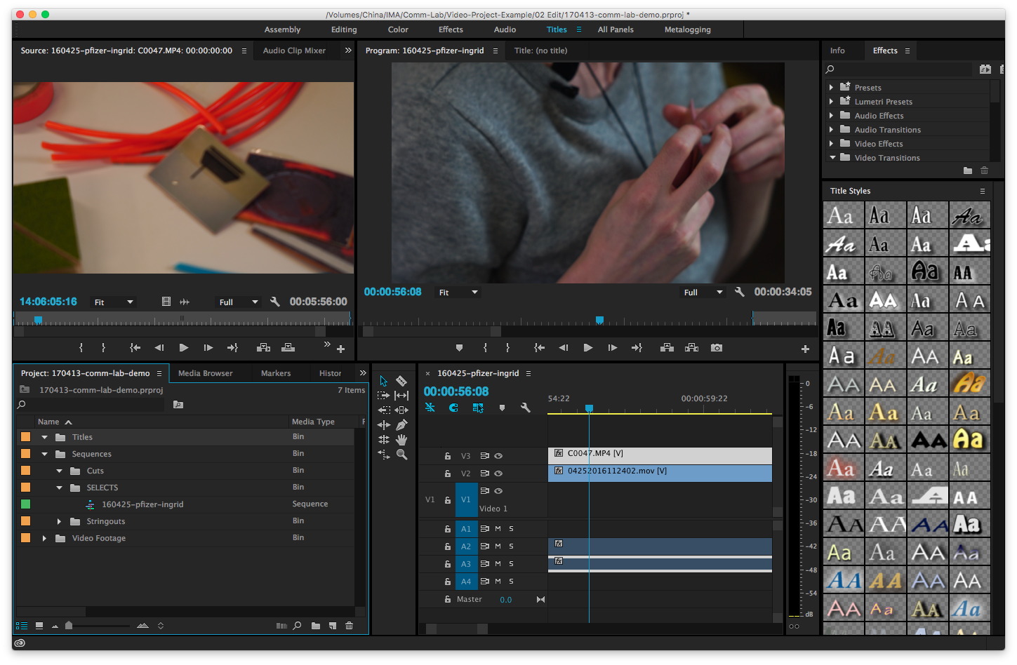
Adding Text
Create a new Bin for your text
Notes:
You probably won’t work with this that much in this context. You aren’t too concerned about the length of the project.

Slide 79
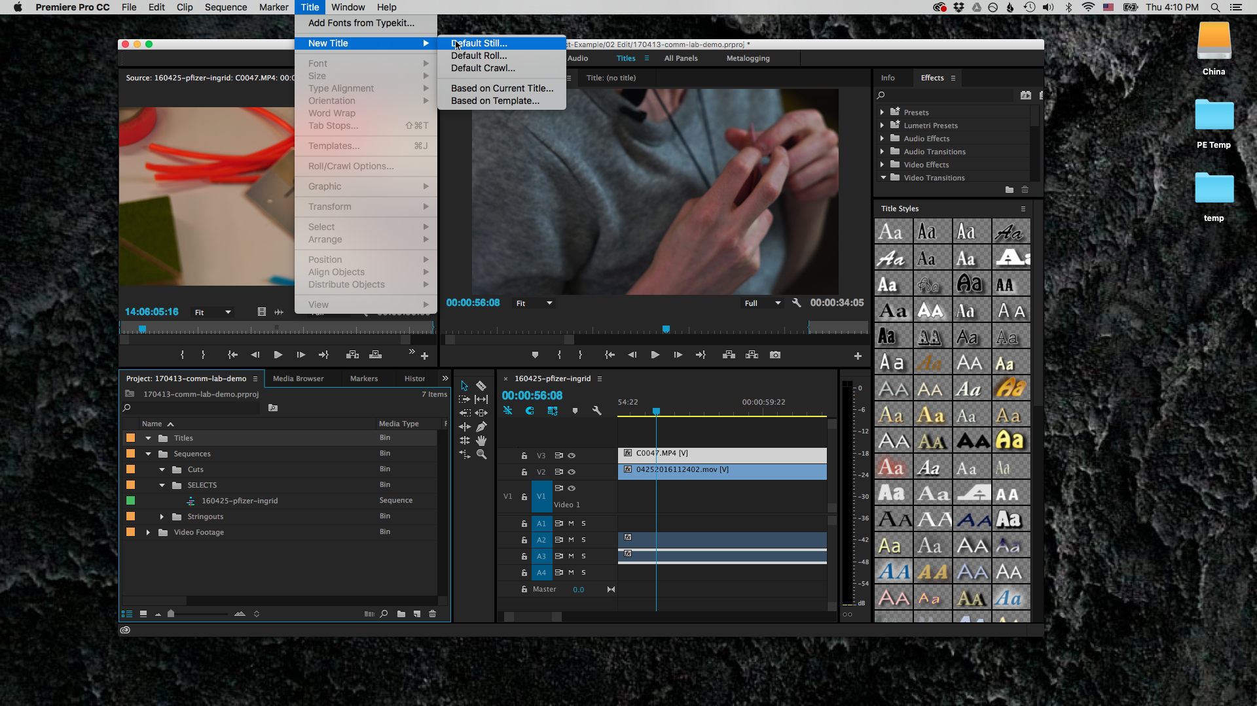
Notes:
You probably won’t work with this that much in this context. You aren’t too concerned about the length of the project.

Slide 80

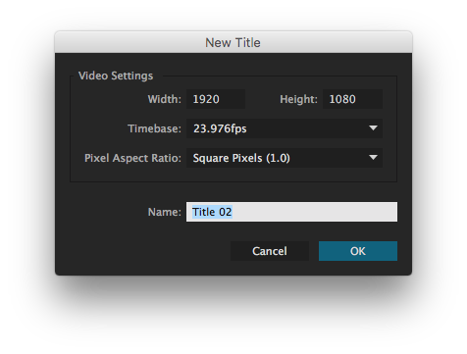
Notes:
You probably won’t work with this that much in this context. You aren’t too concerned about the length of the project.

Slide 81
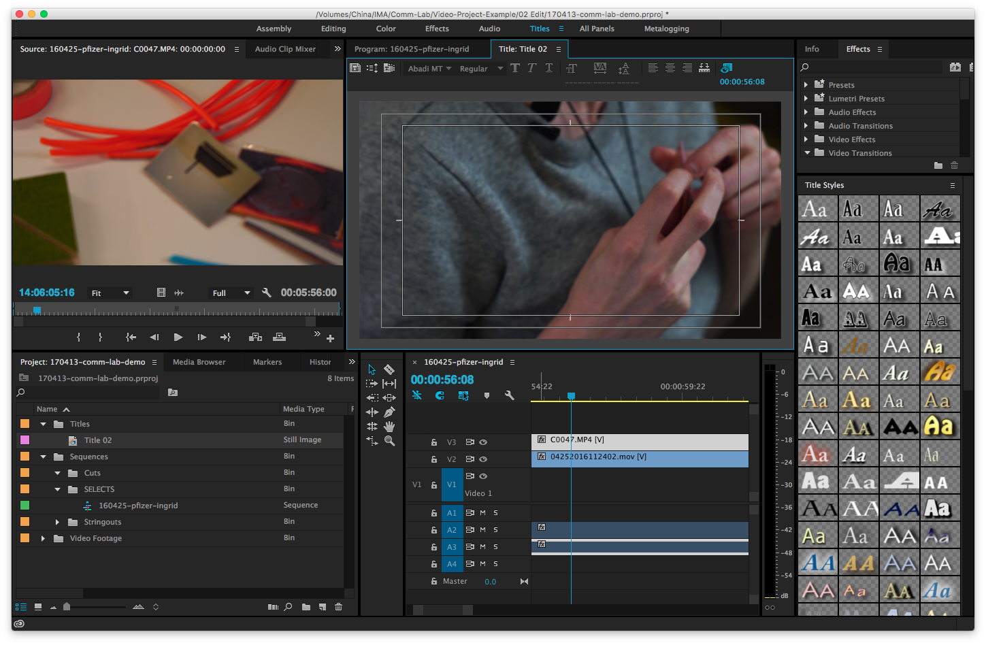
Notes:
You probably won’t work with this that much in this context. You aren’t too concerned about the length of the project.

Slide 82
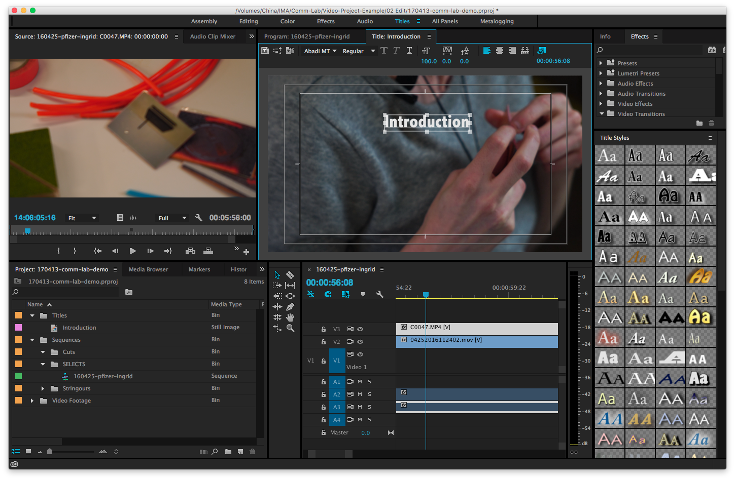
Add text in this workspace
Notes:
You probably won’t work with this that much in this context. You aren’t too concerned about the length of the project.

Slide 83
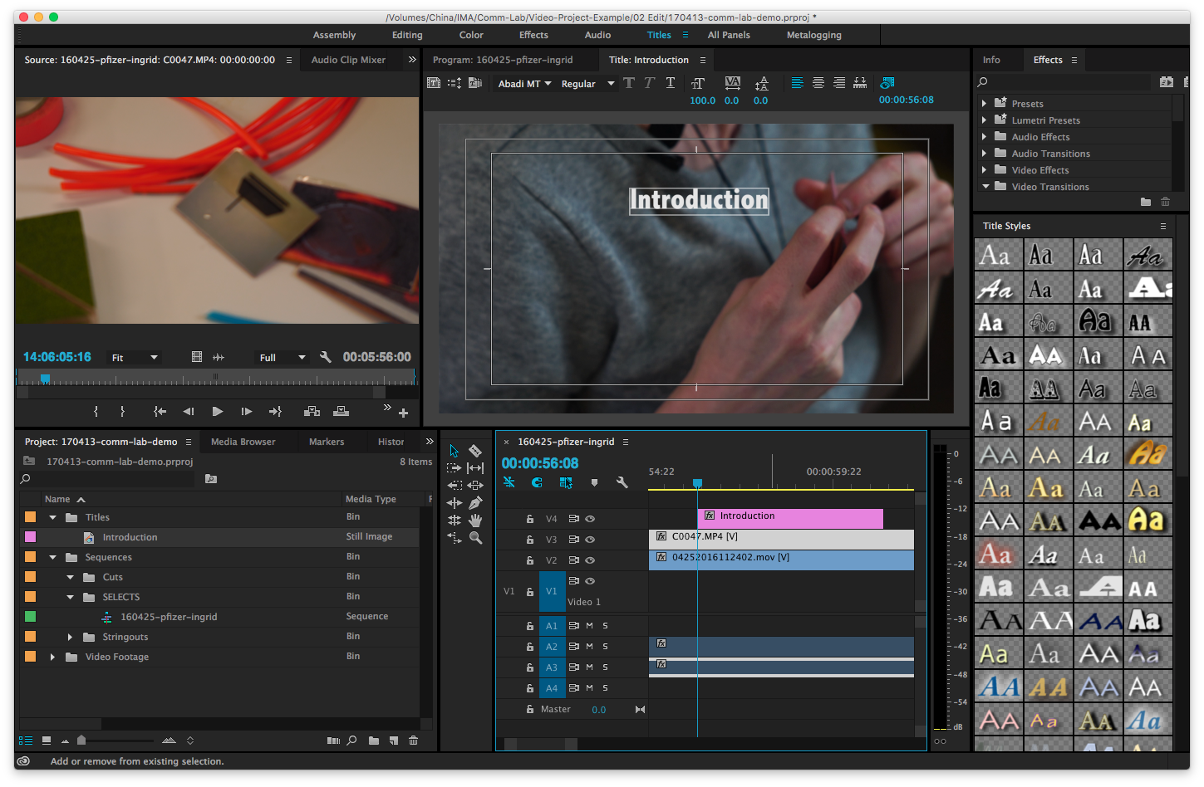
Drag this
Notes:
You probably won’t work with this that much in this context. You aren’t too concerned about the length of the project.

Slide 84
Drag this
into timeline
Notes:
You probably won’t work with this that much in this context. You aren’t too concerned about the length of the project.

Slide 85
Polishing your video

Slide 86
Polishing your video
Color Correction

Slide 87
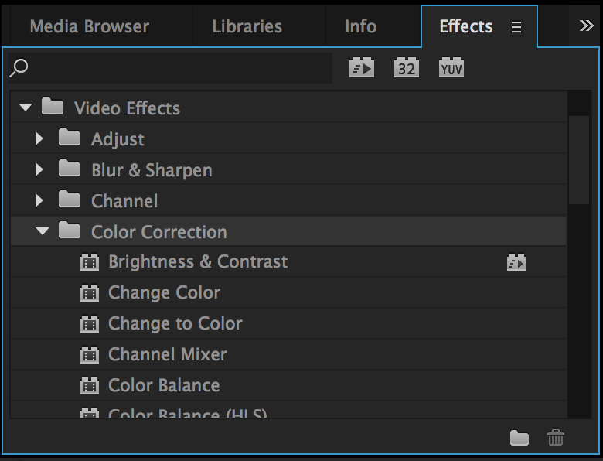

Slide 88
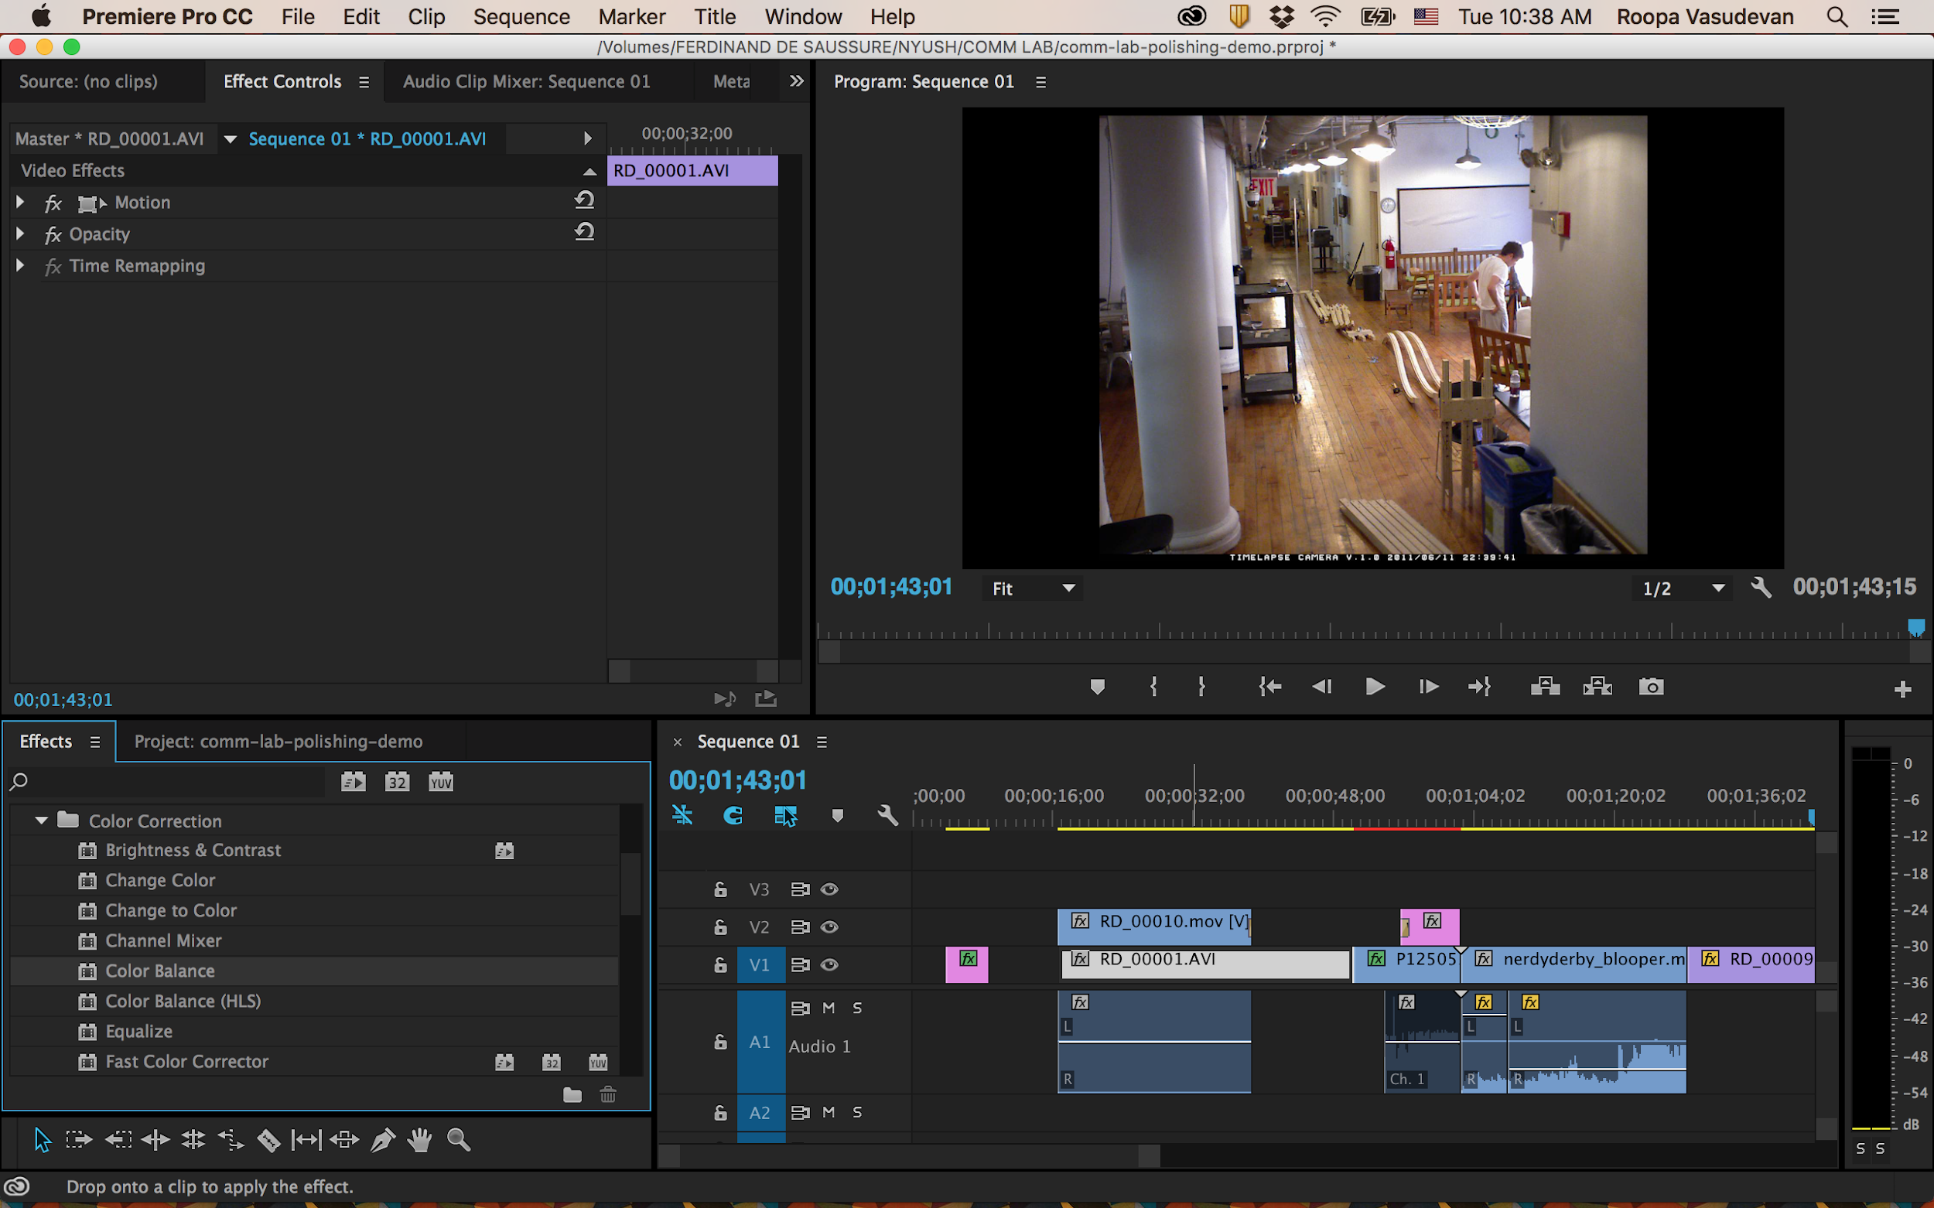
drag and drop the selected effect directly onto the clip

Slide 89
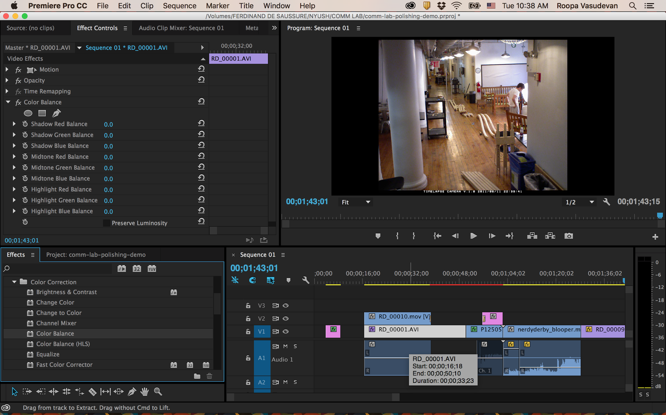
Adjust the numbers to change the color tone

Slide 90
Polishing your video
Audio Editing in Premiere

Slide 91
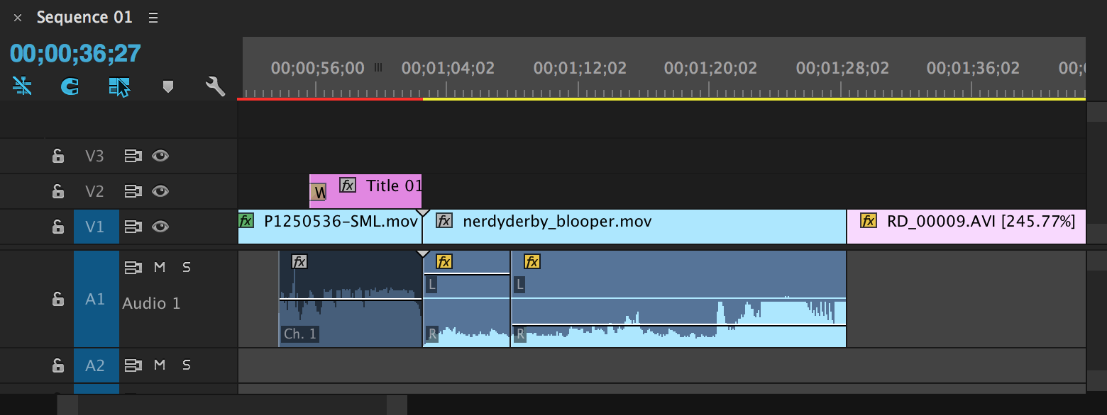
Method 1
Adjust the line in audio track to raise or lower the volume

Slide 92
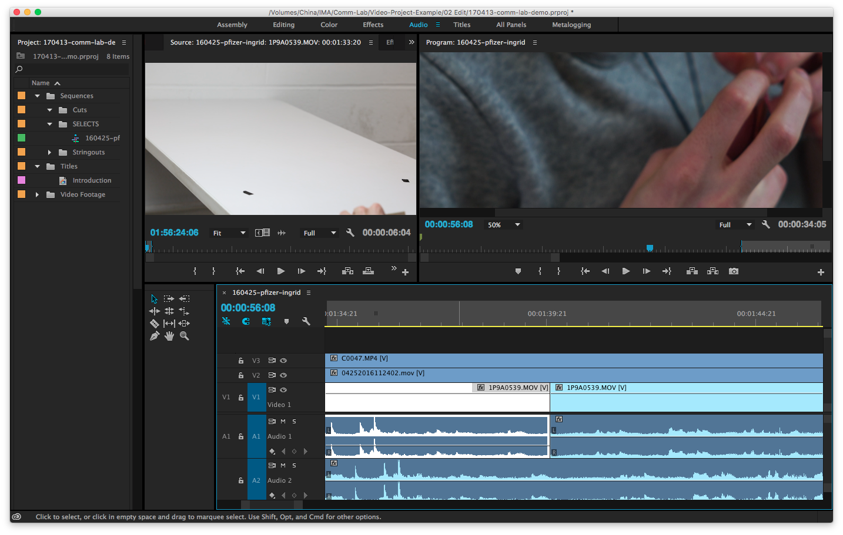

Method 2
Audio Gain (right click on track) to raise and lower volume

Slide 93

Method 2
Audio Gain (right click on track) to raise and lower volume

Slide 94

Pen Tool
For more minute adjustments, use Pen Tool to add points on audio track.

Slide 95
Audio Editing Tip:
Levels should peak between -9 and -6dB.
Some loud sounds can briefly go above this.

Slide 96
If you are consistently over -6dB,
you are too hot/high.

Slide 97

Audio Transitions
To make smoother transitions between cuts

Slide 98
Audio Transitions
To make smoother transitions between cuts
Drag transition onto timeline between two audio clips.

Slide 99


Slide 100


Slide 101

Notes:
Audio polishing - smooth transitions

Slide 102
Polishing your video
Pacing: Split Edits

Slide 103
Pacing: Split Edits
J Cut: Audio from a new scene precedes the new scene.
L Cut: Audio from previous scene carries over into the new scene.
Both of these are extremely effective ways of using audio to transition viewers into a new scene or moment while remaining connected to the previous event.

Slide 104

Pacing: Split Edits

Slide 105
More on Pacing
Leave a beat between thoughts or segments for the audience to digest the information they just heard. Avoid making your video one giant run-on sentence.
Wait for subject to complete action before cutting to a new shot. Wait until a pause or end in what a subject is saying before cutting from the current shot to a new one.
Have someone watch your cut and comment on where they think things are moving too fast, slow, etc.

Slide 106
Exporting your video

Slide 107

Exporting Video
mark in
mark out

Slide 108

Exporting Video

Slide 109

Exporting Video
Codec!

Slide 110

Exporting Video

Slide 111
Codecs
Short for “coder-decoder”: encodes and decodes video signals for playback or transmission.
Codecs basically are the file formats that you compress video into for different purposes.
For editing, compression should be as low as possible (usually this means a bigger file); for posting online, file sizes should be smaller.
To use HTML5 video, your video codec should be set to H.264 (MP4), with audio as AAC.

Slide 112

Video Transcoder: HandBrake
To convert any video format(.mov, .avi) to H.264(MP4) video format

Slide 113
More on codecs
http://diveinto.html5doctor.com/video.html

Slide 114
Sync sound + video

Slide 115


Slide 116


Slide 118


Slide 120


Slide 122


Slide 123

Notes:
Rename as same filename as the Raw media folder. Click Save

Slide 124

Notes:
Rename as same filename as the Raw media folder. Click Save

Slide 125

Notes:
Rename as same filename as the Raw media folder. Click Save

Slide 126
Notes:
Rename as same filename as the Raw media folder. Click Save

Slide 127
Notes:
Rename as same filename as the Raw media folder. Click Save

Slide 128
Notes:
Rename as same filename as the Raw media folder. Click Save

Slide 129
Notes:
Rename as same filename as the Raw media folder. Click Save

Slide 130

Notes:
Rename as same filename as the Raw media folder. Click Save

